Slide 1
读后续写

Slide 2
读后续写各档评分标准对比
内 容
语 言

Slide 3
卷面 | 1、字迹潦草，乱涂乱画
 | 2、段落太多，三段甚至四段
内容 | 1、内容前后矛盾 | （1）碎杯子和破盒子已经扔到垃圾桶了，然而用胶水粘起来送给妈妈了。
 |  | （2）明明已经没钱了，然而又去商店买东西。
 |  | （3）本来就在厨房里，然而第一句就写我们跑进了厨房。
 |  | （4）我们要制作礼物，然而却写带妈妈看节目。
 |  | （5）明明是母亲节，然而却说祝妈妈生日快乐。
 | 2、不衔接 | （1）与第一段首句不衔接。两个人环顾四周发现了一个超市。
 |  | （2）与第二段首句不衔接。误认为首句是完整的句子。
 |  | （3）第二段首句看到妈妈哭了，我们却开心地笑了。
 | 3、节外生枝 | （1）男孩又跑回来道歉、帮忙。
 |  | （2）姐姐回来了。
 |  | （3）爸爸也来了。
 |  | （4）妈妈感慨失业了，日子不好过。
 | 4、人称错误 | （1）我是谁？
 |  | （2）他们是谁？
语言 | 语法错误多
问题汇总

Slide 4
A boy on in-line skates moved around the corner and crashed into me before I jumped out of the way. We fell into a sprawling(摊开四肢躺着) heap as the box I’d been carrying flew from my hands and landed in the street with an ugly beat. A moment later, a car whizzed past, sending the box flying in circles.
The skater got up, mumbled（含糊）sorry, and ran away around the corner.
“Are you OK, Emily?” Aiden asked.
“I think so.” My arm had slapped the sidewalk hard. I stood and slowly moved it in circles.
“Oh no! Look at Mom’s present!” Aiden’s face was red.
I picked up the crushed box and opened it. The drinking glasses inside were broken. I closed the box and left it in a garbage can on the sidewalk, then started hurrying toward home. Aiden had to run at full speed to keep up with me.
When we got to the apartment, we threw ourselves down on chairs in the kitchen.
“It isn’t fair! Why did that happen?” Aiden said.
“I didn’t even see that guy! He came out of nowhere,” I said angrily.
Aiden’s lower lip trembled. “Mom would have loved these glasses.”
We’d saved our money for weeks to buy glasses with pink flowers on them for Mother’s Day. We have other glasses, but not a full set that matches. I wished I could hang something against the wall and scream, but I knew I couldn’t. I’m the older one. I had to hold it together.
“I wanted to make her happy,” Aiden said.
I thought about how Mom had been before the divorce. She used to joke around and laugh a lot. Now she had a deep worry line between her eyes and hardly ever smiled.
“We’ll think of something else to give her for Mother’s Day,” I said, trying to cheer up Aiden.
“Like what?” he asked. “We don’t have any money left.”
信息1：摔碎的杯子连同盒子已经被扔进垃圾桶，不能再用。
信息3：妈妈喜欢带小花的杯子。
信息2：我们坐在厨房里的椅子上。
信息4：我们已经没有钱了，为自制礼物做了铺垫。
信息5：妈妈离婚前爱说笑，离婚后总是不开心。我们的目标是：让妈妈开心。

Slide 5
Para1: Thinking hard, I said excitedly, “Maybe we can make a present for Mom.”_
Para2:When we saw tears rolling down Mom’s cheeks, _______________
线索1：妈妈喜欢带有粉色小花的杯子。
线索2：妈妈离婚前爱说笑。离婚前的幸福生活。
没有钱了，我们能做什么礼物？
我们自制的礼物打动了妈妈。
我们自制礼物。
妈妈为什么哭？
妈妈被打动。
看到妈妈落泪，我们什么反应？
我们高兴，喜形于色还是和妈妈产生共情？
1、根据两段首句定位续写情节
2、根据第二段首句确定第一段内容
妈妈的感慨。

Slide 6
佳句推荐
So excited was Mom that she pulled us into her warm arms, whispering “Thank you, my children.”
As an old saying goes, “It is love that is much more valuable than wealth.”
On Mother’s day, both Aiden and I were worried, afraid of mom’s disappointment.
Aiden’s eyes sparkled with confusion, as if to ask how.
Pulling us into her arms, she laughed brightly.
Hearing the familiar laughter, how happy I was to see mom’s gloomy days gone.
I poured out my plan to Aiden and he jumped to his feet with excitement.

Slide 7
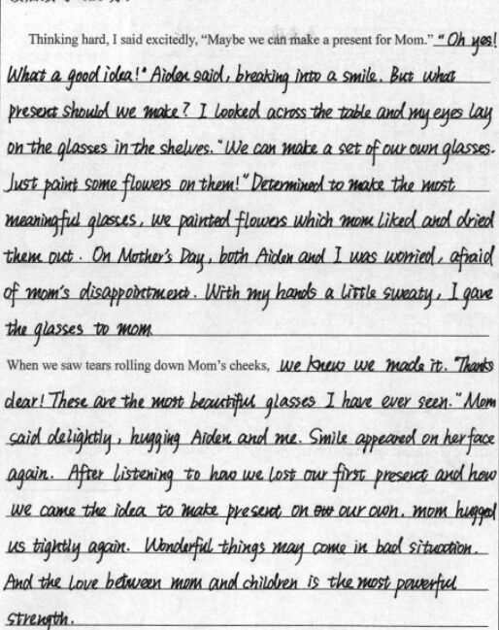
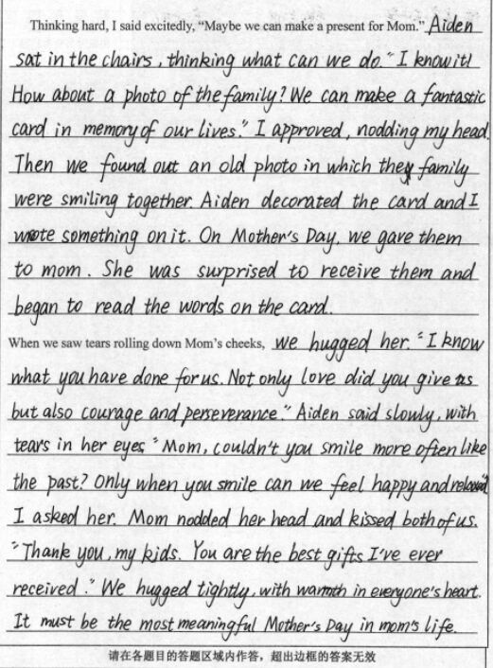
佳作赏析

Slide 8
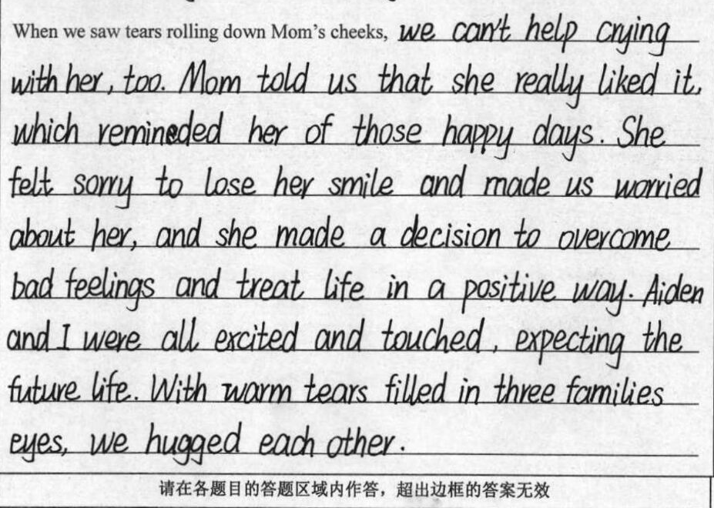
佳作欣赏

Slide 9
A possible version
Thinking hard, I excitedly said, “Maybe we can make a present for Mom.” Aiden’s eyes sparkled with confusion, as if to ask how. Thinking of the broken glasses, I came up with a good idea—why not make a paper glass and decorate it with pictures? I poured out my plan to Aiden and he jumped to his feet with excitement. The next three days witnessed our effort(s) to design, make and color the paper glass. Eventually, a special work of art was born! On Mother’s Day, we carefully took it out and couldn't wait to give mom a surprise, only to find her eyes red and wet.
When we saw tears rolling down Mom’s cheeks, Aiden blurted out, “Mom, you are crying! Are you sad with it?” His voice was worried and upset. But mom stroked the paper glass lovingly as if it was the most precious jewel. Pulling us into her arms, she laughed brightly, “No. Never have I had a more beautiful gift than this. I am just too moved.” Hearing the familiar laughter, how happy I was to see mom’s gloomy days gone! How I wished Mom could laugh as often as before!

