Slide 1
应用文写作

Slide 2
写作要求
假定你是李华，你的朋友John因选科走班进入了新的班级学习。因不擅长与别人交流，他暂时无法融入新的班级，感到非常苦恼。请你根据以下要点给他写一封回信。内容包括：
1.表示理解并给予安慰；
2.提出建议并给出理由。

Slide 3
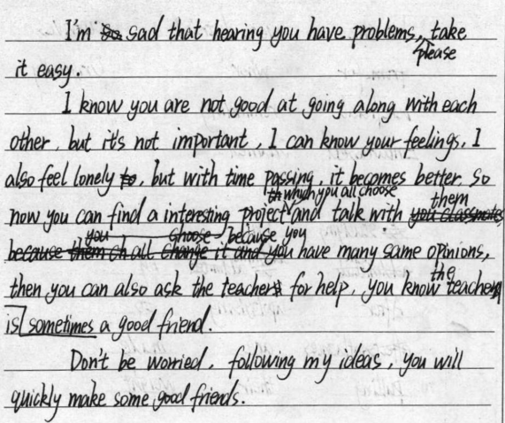
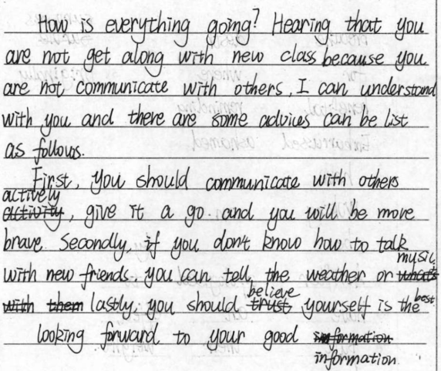
问题1.卷面太乱

Slide 4
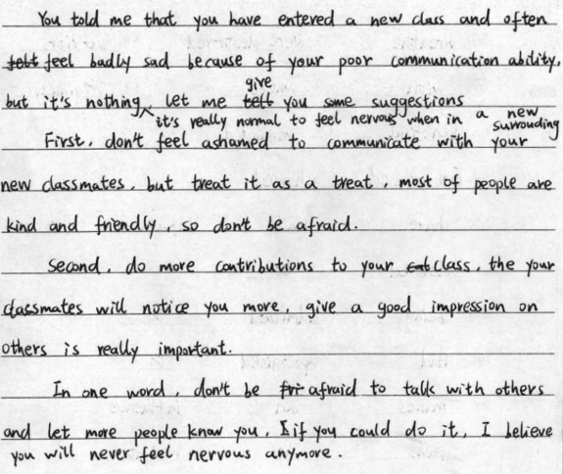
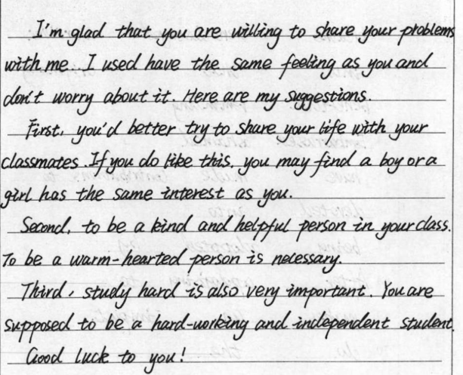
问题2.分段太多

Slide 5
问题3.要点不全或者要点比例分配不合适
1.没有对因暂时无法融入新的班级感到苦恼而表示理解并给予安慰；
2.无法融入新班级篇幅过多，导致建议篇幅过少。

Slide 6
问题4.结尾处理不当
提完建议结尾处只写期待收到你的回复。
I hope these suggestions mentioned above will be beneficial to you.
Hopefully, I wish you could take my advice into consideration/account.

Slide 7
问题5.缺少过渡衔接
To begin with/First and foremost/ First of all,…
Besides/What’s more/Additionally/In addition,…
Last but not least,…

Slide 8
问题6.词汇语法错误较多
1.表示建议”的词
[U]
[C]
v.
v.
advice
advise
suggest
doing sth.
sb. to do sth.
that…(should) do …
suggestion
doing sth.
that…(should) do …

Slide 9
2.表示”与…相处融洽”的短语
(B3U1学案Period 1---Vocabulary---interpersonal relationships)
get along/on well with…
be in harmony with…
be on good terms with…
fit in with…

Slide 10
3.表示”做某事有困难”的短语
have a hard time (in) doing sth.
have difficulty/trouble/problems (in) doing sth.
4.表示”适应”的短语
adapt/adjust (oneself) to
be adapted/adjusted to
written
5. write--- (过去式)--- (过去分词)
--- (现在分词)
wrote
writing

Slide 11
6.表示”参加活动”
take (an active) part in an activity
participate in an activity
7.表示”不用担心。”
Don’t worry.
Don’t be worried.
8.非谓语动词的使用

Slide 12
佳句赏析
Hearing that you have trouble adjusting to the new surroundings, I’m writing to give you some suggestions.
There was a time when I have the same situation where I can’t fit in with my new classmates.
I suggest that you (should) take an active part in the activities where you will have a chance to communicate with your classmates.
I hope these suggestions mentioned above will be beneficial to you.
You can depend on it that you are sure to adjust to the new class soon.
I hope everything works out.

Slide 13
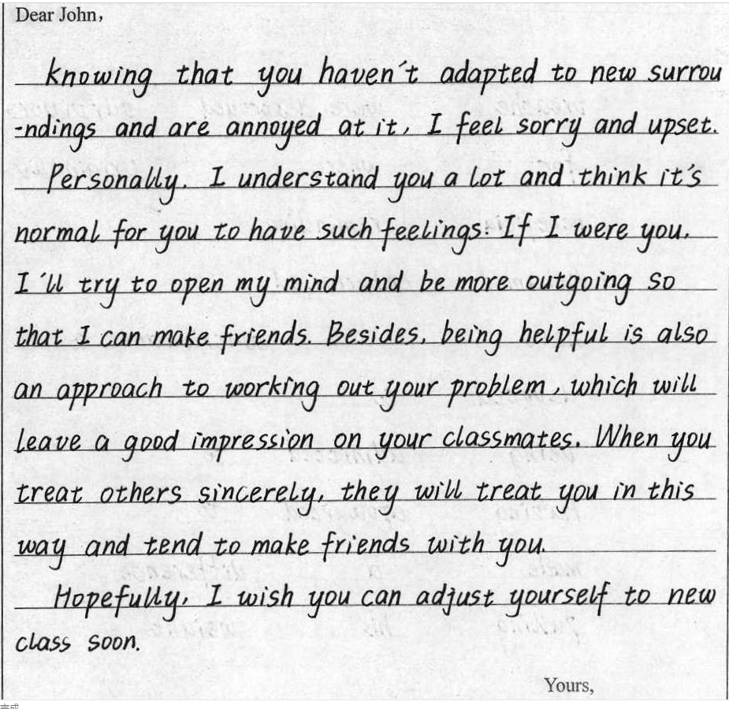
佳作赏析

Slide 14
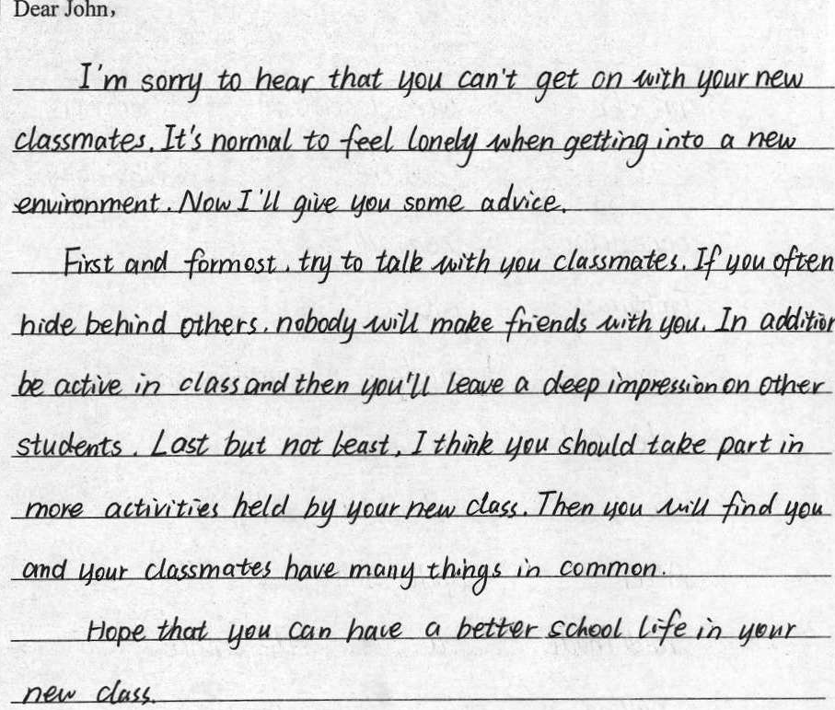
佳作赏析

Slide 15
Possible version:
Dear John,
I am glad that you are willing to tell me your trouble. In your letter, I learn that not good at communicating with others, you can not be adjusted to the new class, about which you feel upset. I’m writing to give you some advice.
First and foremost, it is suggested that you (should) make more new friends who can share your hobbies and ideas. Additionally, why not take an active part in the activities where you can exchange your opinions with others? Last but not least, be a good listener. As is known to all, listening is an art which makes it easier to build a good relationship with others.

Slide 16
Hopefully, I wish you could take my advice into consideration. Looking forward to your early reply!
Yours,
Li Hua

