Slide 1
读后续写

Slide 2
评分细则
档次 | 分值 | 细则
第六档 漂漂亮亮 | （13—15分）优 | 1、创造了丰富、合理的内容，富有逻辑性，续写完整，与原文融洽度高。 2、使用了多样且恰当的词汇和语法结构，表达流畅，语言错误很少，且完全不影响理解。 3、自然有效地使用了段落间、语句间衔接手段，句子结构清晰，前后呼应，全文连贯。
第五档 干干净净 | （10—12分）良 | 1、创造了比较丰富、合理的内容，比较有逻辑性，续写比较完整，与原文情景融洽度较高。 2、使用了比较多样且恰当的词汇和语法结构，表达较为流畅，有个别错误，但不影响理解。 3、比较有效地使用了语言间的衔接手段，全文结构比较清晰，意义比较连贯。
第四档 勉勉强强 | （7—9分）及格 | 1、创造了基本合理的内容，有一定的逻辑性，续写基本完整，与原文情景相关。 2、使用了比较恰当的词汇和语法结构，表达方式不够多样性，表达有些许错误，但基本不影响理解。 3、使用了语句间的衔接手段，全文结构比较清晰，意义比较连贯。

Slide 3
档次 | 分值 | 细则
第三档 差强人意 | 4—6分 | 1、创造了基本完整的故事内容，但有的情节不够合理或逻辑性不强，与原文情景基本相关。 2、使用了简单的单词和语法结构，有部分语言错误和不恰当之处，个别部分影响理解。 3、尚有语句衔接的意识，全文结构基本清晰，意义基本连贯。
第二档 堆砌 | 1—3分 | 1、内容、逻辑上有较多重大问题，或部分内容抄自原文，续写不完整，与原文情景基本脱节。 2、所使用的词汇非常有限，语法结构单调，错误极多，严重影响理解。 3、几乎无使用语句间衔接手段，全文结构不清晰，意义不连贯。
第一档 胡言乱语、空白、抄袭 | 0分 | 未作答；所写内容太少或无法看清以致无法评判；所写内容全部来自原文；与题目完全不相关。

Slide 4
内容要点可以有不同的表达形式。
如果书写太差以至影响交际分数降低一个档次。
可以适当发挥，但应该紧扣主题。
细节说明

Slide 5
语篇解读
主题语境：人与社会 ：家庭生活
语篇话题： 祖母与孙子Spencer一起练习滑板
主要人物： I, my husband and Spencer
突出的主题: 温馨欢乐的家庭生活

Slide 6
语篇 | 情节线（动作词汇） | 情感线（情感词汇）
Para 1 | 祖父母通常有有趣的名字。这些名字是他们的孙子决定的。我的第一个孙子叫我“娃娃”。 | 温馨欢乐的家庭生活（Sweet and happy）
Para 2 | 听到我的孙子叫我娃娃是很好的，甚至是可爱的。有一次，我从幼儿园把五岁的斯宾塞接回家和我们一起过夜。斯宾塞想我展示他在滑板上学到的新技巧。 | 斯宾塞想展示滑板技巧。Want to
Para 3 | 看到孙子熟练的展示滑板，曾经玩过滑板的作者一时技痒也和孙子一起练习。并作出了一个向前翻滚的滑板动作。 | 斯宾塞炫酷的滑板动作让作者禁不住也练习了起来。并一心想要做一个高难动作。Cool/Luckily/So far, so good/with every intention
Para 4 | 作者尝试失败，摔到肘部。伤势不重。斯宾塞反应快速，从冰箱取来了冰袋。 | 突发意外，斯宾塞反应迅速，处理得当。但是作者的自尊心却受到了那么一点的挫败。（It helped my arm, but not my pride.）
Para 5 | 作者被丈夫责备，但是斯宾塞却得到了表扬。斯宾塞很自豪并且说自己懂得在出现紧急情况的时候要拨打911电话求助。 | 斯宾塞处理得当得到表扬。作者受到责备。blame me seriously/praise/proud
第一段续写 | My husband helped Spencer practice calling 9-1-1 emergency call, pretending I hurt my head seriously. 我丈夫帮斯宾塞练习拨打911紧急电话，假装我的头伤得很严重。 斯宾塞的学习拨打911的过程。作者和丈夫提醒和帮助。 | 以作者受伤为契机，教斯宾塞学习拨打911。 斯宾塞：兴奋/认真/？ 作者和丈夫：? 温馨欢乐的家庭生活

Slide 7
问题总汇
卷面 | 1、字迹潦草，乱涂乱画。
 | 2、段落太多，二段甚至三段。
内容 | （1）真的给911打电话，医生来了夸奖孩子聪明。
 | （2）没有把“给911打电话”作为主要内容，只是用一句话带过。
 | （3）是“我”帮助了Spencer打电话而非“我的丈夫”。
 | （4）一段时间后，“我”的头受伤了，Spencer给911打电话。
 | （5）完全跑题，压根就没有提到打电话。
语言 | 语法错误多。

Slide 8
如何写？
Grandparents often have interesting names. Their grandchild decided on those names. My firstborn grandchild named me "Doll". I will never forget the day Spencer hugged me and, in front of a roomful of people, called me "Doll. My Doll Baby!" From that point on, I was known as Doll or Doll Baby. It's a given.
For the most part, it's fine, even endearing, to hear my grandchildren call me Doll. But there was one occasion... I picked up five-year-old Spencer from kindergarten and brought him home to spend the night with us. When we arrived home, Spencer wanted to show me a new trick he learned on his skateboard.
Spencer was pretty good. He had learned how to step on the back of the skateboard so that the front tipped up, and then quickly put his front foot down on the board and take off. Cool!
信息1：多次提到Spencer喊自己的祖母“Doll”。因此，在续写中，当Spencer给911打电话时应当有所体现。

Slide 9
Then it was my turn. Luckily, I had played around with skateboards in my day. I put my right foot on the back of the board and tipped up the front. So far, so good. I brought my left foot down with every intention of rolling forward.
Good intentions. Bad form. I fell hard on my elbow(肘部） as the skateboard flew across the driveway. My injury was minor, but Spencer raced into the house and took a Boo-Boo Bunny(波波兔）ice pack from the freezer to bring me comfort. It helped my arm, but not my pride.
Seeing this, my husband Tom blamed me seriously. "Do you realize how bad that could have been?" He shouted. "I mean, what if you had hit your head and had been unconscious(昏迷的）?” He was right. That evening, Spencer climbed onto our bed. Tom praised him for getting the Boo-Boo Bunny and taking care of me. "What if Doll had been badly hurt, Spencer? Do you know what to do in an emergency?" Tom asked. "Yes! Call 9-1-1!" Spencer was proud he remembered what to do.
信息2：Spencer机智聪明。说明Spencer能够较为顺利地完成打电话练习。
信息3：说明Doll 受伤并非事实，只是一个假设

Slide 10
My husband helped Spencer practice calling 9-1-1 emergency call, pretending I hurt my head seriously.
角色
认真研读段首句！
Pretend
使用的道具
Practice
Spencer打电话时会说什么，以及会出现什么样的问题
Help
1.Grandpa 配合Spencer完成打电话练习
2.帮助解决Spencer打电话过程中出现的问题
打完电话后三个人的感受

Slide 11
佳句欣赏
1. Hearing what his grandpa said, Spencer nodded in agreement.
2. Spencer rushed to pick up his toy phone and press the buttons as
if it were a real phone.
3. He was very proud, his smile shining like a diamond.
4. Proud of him, I felt like the sunshine was kissing every inch of
my skin.
5. By no means can words express his pride.
6. The next three minutes witnessed his efforts to learn how to make
an emergency call.
7. After making the call, a spark of delight glittered in his eyes.
8. We expressed our satisfaction with his making the call.

Slide 12
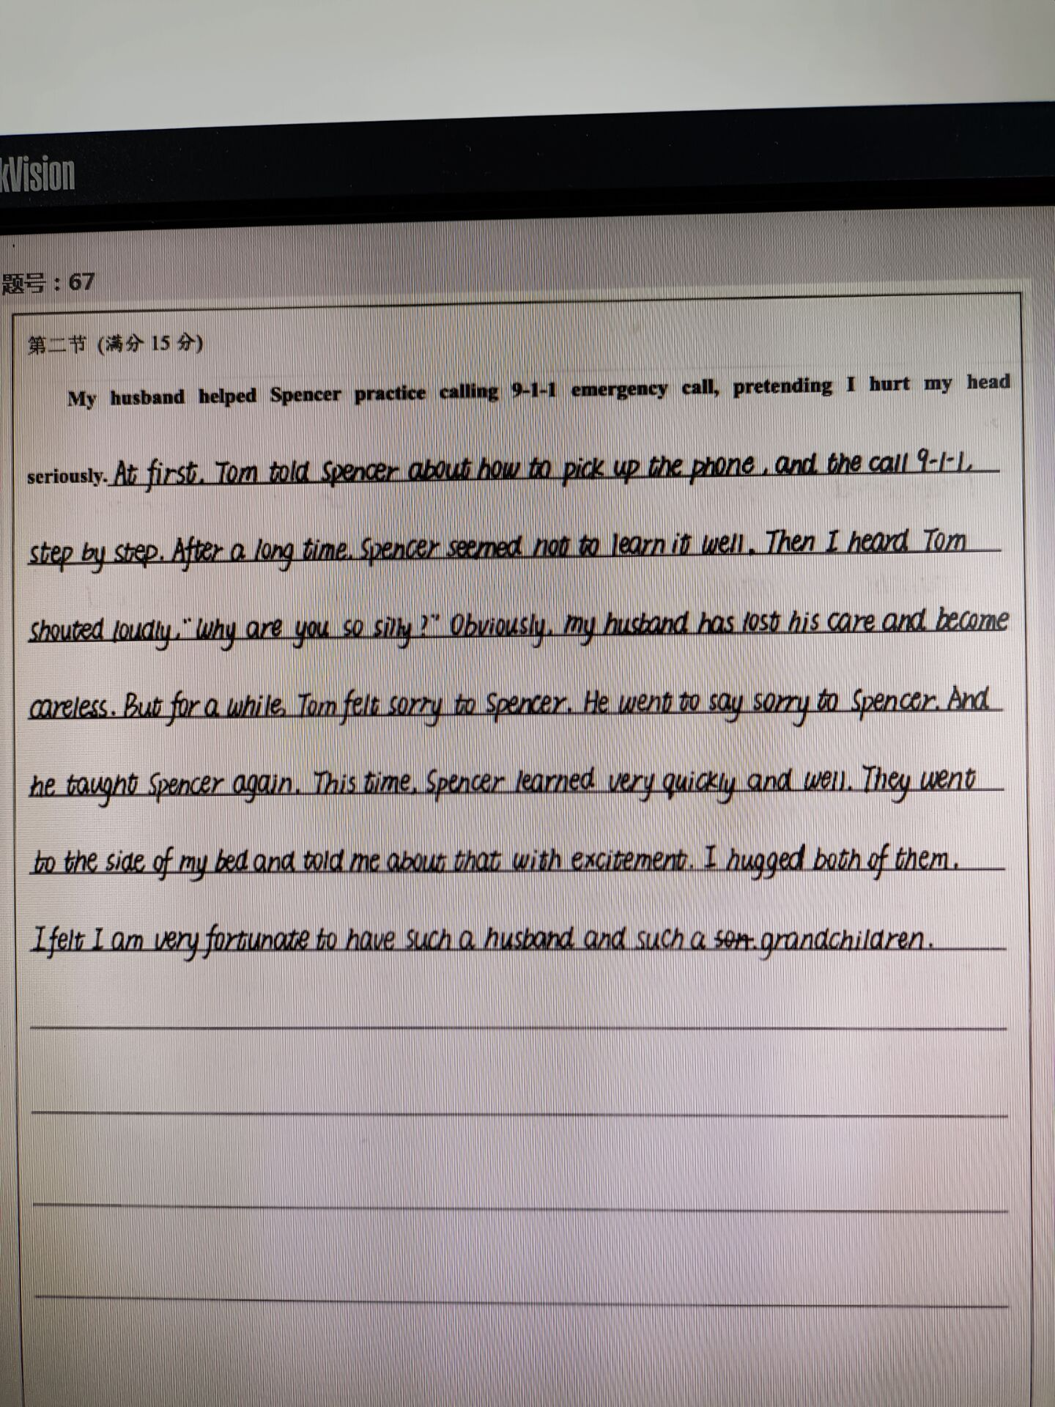
他山之石

Slide 13
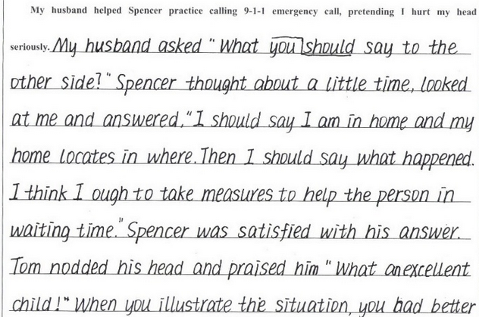
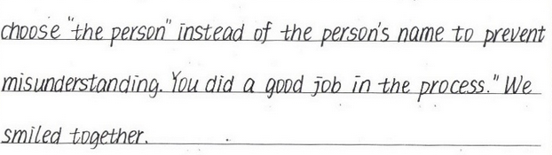
他山之石

Slide 14
续写范文
My husband helped Spencer practice calling 9-1-1 emergency call, pretending I hurt my head seriously. He put up his hand as if it were the phone, his thumb the earphone and his little finger the mouthpiece. “9-1-1. What’s your emergency?” Spencer brought up his pretend hand phone and spoke clearly into his fingers. “Help! My Doll fell off the skateboard and hurt her head!” On seeing this, Tom and I smiled at each other and we couldn’t help laughing. “Uh, Spencer,” Tom said. “There are probably times you need to call her Grandma.” Spencer nodded, his eyes twinkling with delight.

