Slide 1
基础知识填空解析

Slide 2
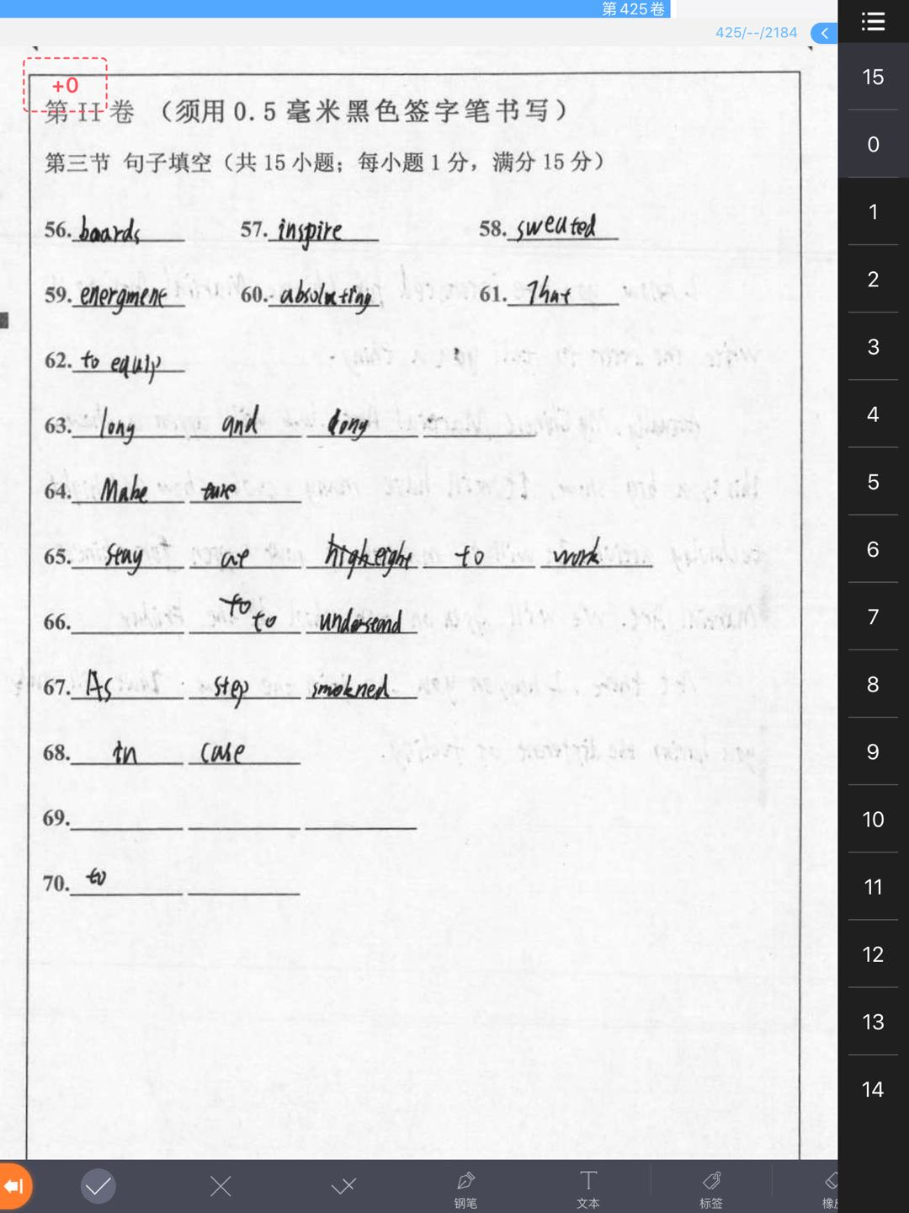
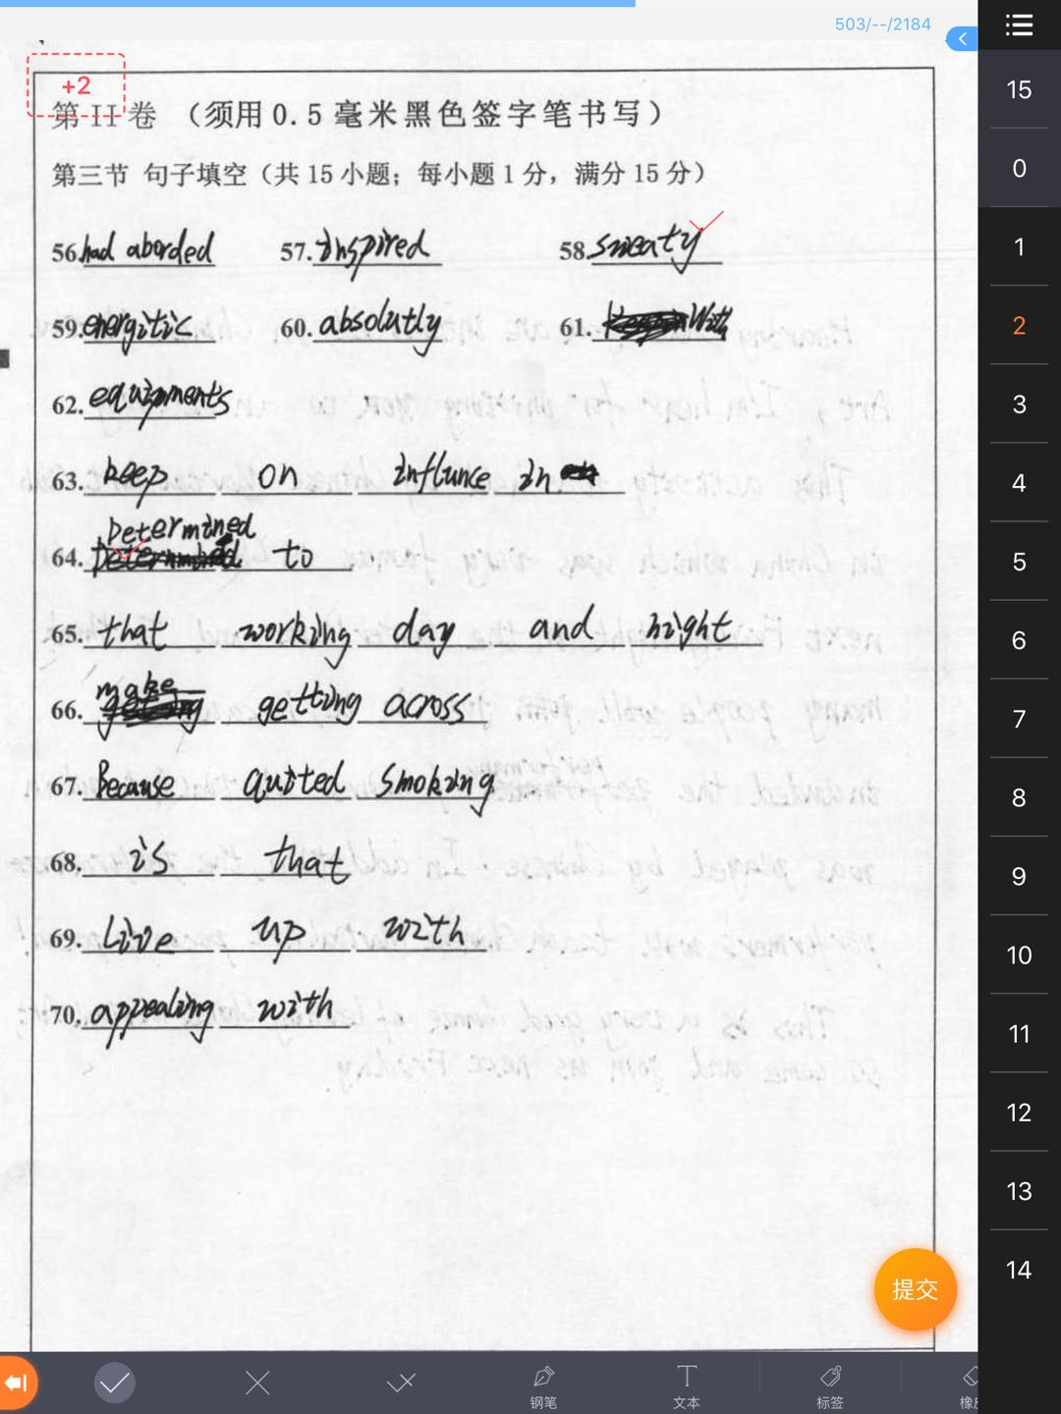
字迹潦草，涂改严重

Slide 3
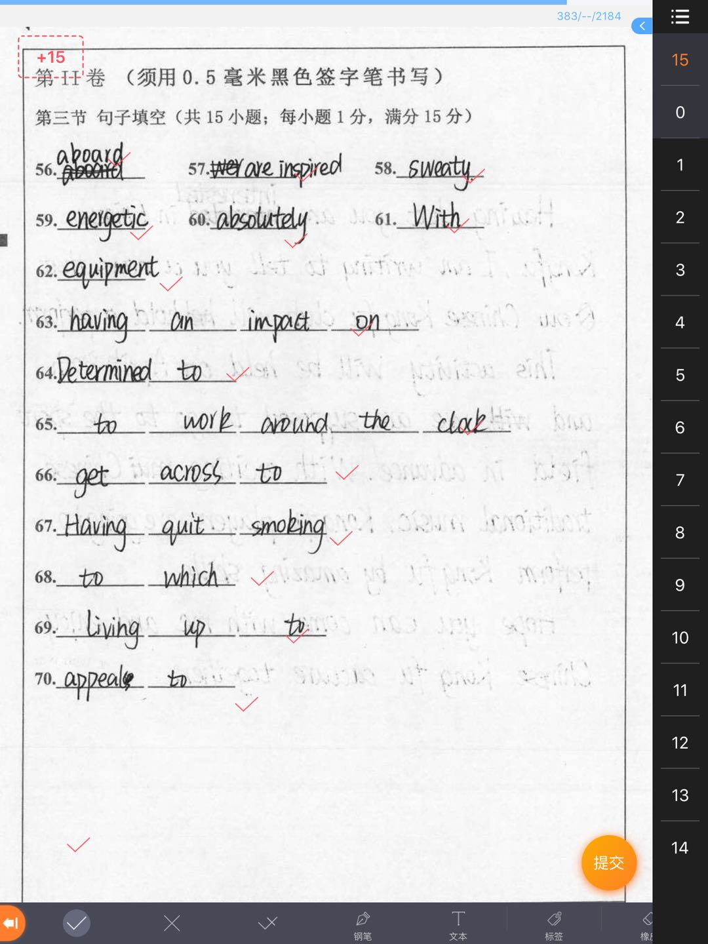
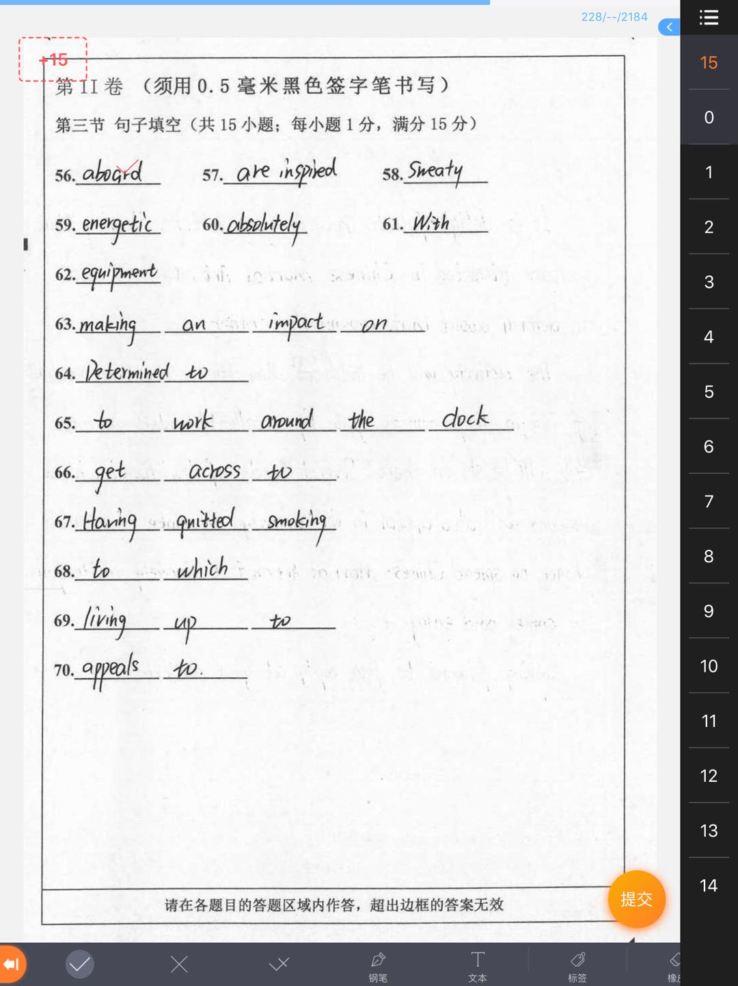
优秀试卷展示

Slide 4
56. The plane crashed, killing all 157 passengers ___________（board). 句意：飞机坠毁，机上157名乘客全部遇难。 解析：表示在车/船/飞机上，用adv. aboard=on board 易错：易与broad(adj.宽阔的)，abroad(adv.在国外）混淆; board (v. 登上（船、车、飞机）；寄宿 n. 木板；董事会；伙食 57. All too often, more people ___________(inspire) to devote themselves to the country’s economic construction. 解析：all too often 常常; 时常,句子用一般现在时，更多的人被鼓励致力于国家经济建设，句子缺少谓语动词，more people和inspire构成被动关系 易错：were ,was inspired
aboard
are inspired

Slide 5
58.After working in the sun for hours in such hot weather, he looked very tired and sweaty(sweat).
解析：sweaty adj.汗流浃背的；出汗的 59. You had better set aside some time every day for sports so that you can keep yourself____________(energy).
解析：使自己保持精力充沛的状态 keep sb +adj. 使某人处于某种状态
易错：energtic 60.Are you __________(absolute)sure that you have turned off all the lights before leaving the room?
解析：修饰adj. sure，用adv. absolutely
易错：absolutly 61. With the teacher's instructions in mind, you are sure to make greater progress.
With….in mind 考虑到…, 出于...目的
energetic
absolutely

Slide 6
62. You don‘t need some expensive __________(equip); even the ball doesn’t have to cost much money. 解析：Expensive + [U].equipment 不可数名词 Facility [C].n.设施，设备 63. He set up a blog to have the photography _________________________________________（一直影响) the environmental issues. 句意：他建立了一个博客，目的是能让照片一直对环境问题有所影响 解析:考察have sb/sth doing 让某人/某事一直… 影响 make/have an impact on =have an influence/effect on
equipment
Making/having an impact on / having an influence/effect on

Slide 7
64. Determined to (下决心)work harder from now on, I hoped to get “A”in next week’s English exam. 解析：考察短语 be determined to do sth,下定决定做某事，逻辑主语与句子主语一致 65. He has made it a rule to work around the clock/day and night every day.(夜以继日地工作) 解析：it做形式宾语，to do不定式做真正的宾语 易错：部分同学记忆不精准，work around a clock/days and nights 66. The performers of course sang in Chinese, but the music, exaggerated movements helped get the meanings across to the audience. (使观众理解含义) 解析：get across vt. 解释清楚，传达给,横过（马路、河等）; vi. 被理解（不用被动）

Slide 8
67.因为以前戒过烟，所以他再也不想尝试了(分词作状语) Having quit/quitted/stopped smoking before, he didn‘t want to try it any more. 解析：考察现在分词做原因状语，现在分词与句子的谓语动词有明显的先后顺序，用having done的结构表原因；戒烟，quit/stop smoking 注意 quit过去分词 quit/quitted; stop 过去分词stopped 易错：smork，quited
68.但是，我们很少意识到的是，英语影响到我们生活的每个角落的程度。 But we seldom realize the extent to which English has influenced every corner of our lives. 解析：考察定语从句中介词+which的用法，…的程度 to the extent是固定搭配

Slide 9
69.Is there anyone living up to (不辜负) the parents’ expectations in the future?
解析：考察there be 句型中 非谓语动词的使用，anyone 和 live up to 构成主动关系，用现在分词形式
70.体育运动已经成为很重要的娱乐形式，吸引着男士和女士们。 Sport has become an important form of entertainment, which appeals to both men and women. 解析：which引导的非限制性定语从句表示补充说明的结果，从句缺少谓语动词，时态为一般现在时，appeal to sb吸引某人

