Slide 1
Period 4 Developing ideas

Slide 2

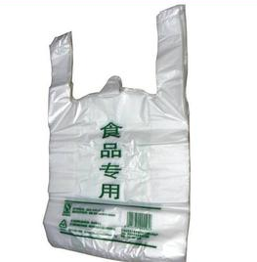
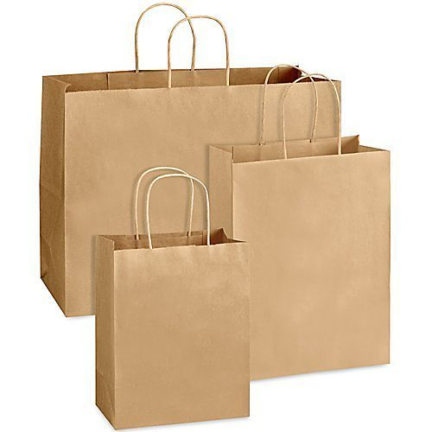

Step 1 Lead in
Task: Look at the questions about “green living” and tick your answers.
1. Which shopping bag is more environmentally friendly?
□ A plastic bag.
□ A paper bag.
□ Neither of them.

Slide 3
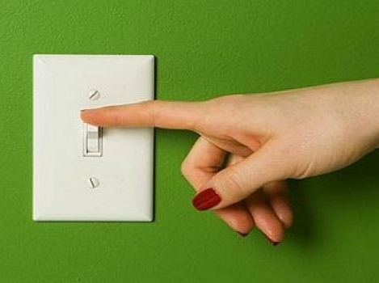
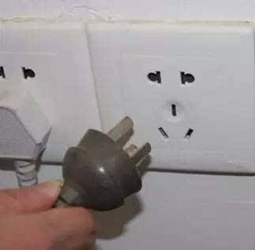
2. What should you do to save energy when leaving your room?
□ Turn off a device.
□ Unplug a device.
□ Neither of these.

Slide 4
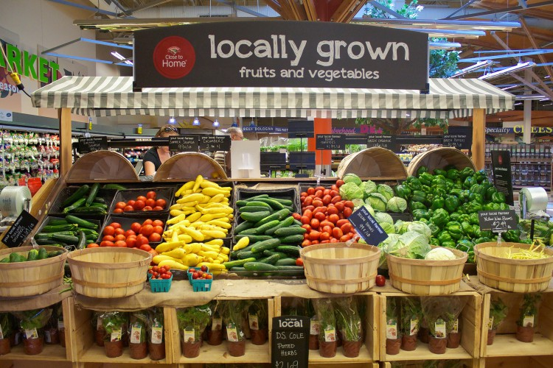
3. What food is better for the environment?
□ Food produced near to where you live.
□ Food produced far from where you live.
□ Neither of them.

Slide 5
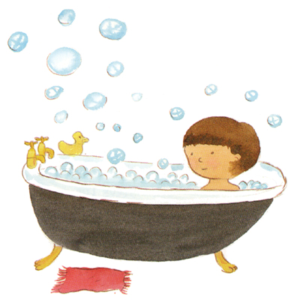
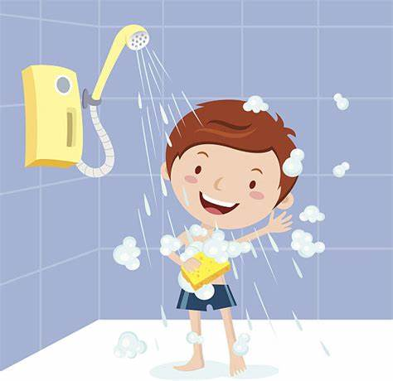
4. Which uses less water?
□ Taking a bath.
□ Taking a shower.
□ It depends.

Slide 6

Step 2 About the text
Task 1: Read the four subheadings in the passage and decide if they are true or false.
What’s really green?
Paper shopping bags are better than plastic ones.
When you turn off a device, it stops using power.
Eating local food is good for the environment.
It’s better to take a shower than a bath.

Slide 7
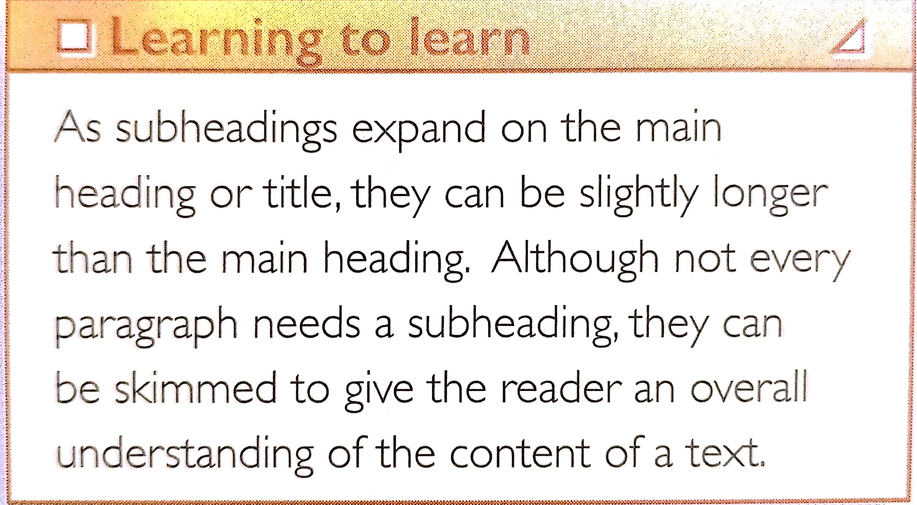
Task 2: Read “Learning to learn” on P68, and answer the following question.
What's the function of subheading?

Slide 8
Task 3: Summarize the main idea of the passage.
There are some “green truths” are not true, so it's worth checking common ideas and opinions to see what's really green.

Slide 9
Step 3 Within the text
Task: Read the effects and complete the causes of these according to the passage.
CAUSES
EFFECTS
1. Making a paper bag uses more energy and water than making a plastic bag. It also produces more greenhouse gases.
Paper bags are not good for the environment.

Slide 10
CAUSES
EFFECTS
2. Devices turned off go into stand-by mode and still use power.
Turning off a device won't stop it from using power.
3. Local produce sometimes might use more energy and produce more greenhouse gases than produce grown a long way away--even taking into account its transport.
Eating local food isn't always better for the environment.

Slide 11
CAUSES
EFFECTS
4. If you spend more than eight minutes in a shower, you'll use as much water as in a bath--about 50 litres of water.
It's not always better to take a shower than a bath.

Slide 12

Step 4 Beyond the text
1. Which of the “green truths” surprises you most? Give your reasons.
2. Are you aware of any other “green truths” that are not true? Share them with the class.
3. How “green” are you? Share your “green actions” with the class.
4. What can you do to become “greener”?

Slide 13
Step 5 Useful expressions and sentence patterns
1. 意识到
be aware of/ that…
2. 爱护环境
take care of the environment
3.大多数
the majority of
4. 采取措施节约能约
take steps to save energy
5. 把…错当成
mistake…for
6. 花费某人时间做某事
It takes sb time to do sth
7. 出故障; 分解
break down
8. 对......有害处
be bad for
9. 关闭设备
turn off a device
10. 待机状态
stand-by mode
11. 从......泄露
leak from
12. 常识
common sense
13. 在某些情况下
in some cases
14. 把某事考虑进去
take sth. into account
15. 值得做某事
be worth doing

Slide 14
16. However, making a paper bag uses four times as much energy as making a plastic bag and up to three times the amount of water.
然而，生产一个纸袋子所使用的能源是生产一个塑料袋所使用能源的四倍，用水则高达三倍。
常见倍数表达方式：
A+ be+倍数+as +形容词/副词+ as…
A+ be+倍数+形容词/副词比较级+ than…
A+ be+倍数+ the size/ length/ height/ depth/ width…+ of…
A+ be+倍数+ as many/ much+ 名词+ as…
Tips:
表示两倍时要用double或twice, 表示三倍或三倍以上用“基数词+ times”。
有时可以用分数、百分数、half等代替倍数。

Slide 15
句型转换：
The red ruler is three times as long as the yellow one.
1)用“倍数+比较级”改写
2)用“倍数+ the length of…”改写
The red ruler is twice longer than the yellow one.
The red ruler is three times the length of the yellow one.

Slide 16
17. To make sure your appliance is in fact off, remove the plug from its power supply.
为了确保你的设备完全关闭，请把插头从电源供应器上拔掉。
写出下列句中remove的含义：
When fat and salt are removed from food, the food tastes as if it is missing something.
It was not until he removed his sunglasses that I recognized him.
The busy work has removed the workers’ homesickness.
The president could only be removed from power once free elections were organized.
除去
摘掉
消除
免除…的职务

Slide 17
Step 6 Writing
Task 1: Useful expressions on Page 71.
1.号召某人做某事
call on sb to do
2.敦促某人做某事
urge sb to do
3.把剩下的食物带回家
take leftover food home

Slide 18
Task 2: Discuss the environmentally friendly campaign you know. (Open)
Task 3: Read the persuasive letter and get the structure of the letter.
1. The purpose of the letter, the existing problem and the causes.
2. The proposed actions.
3. Propose again.

Slide 19
Task 4: Read the letter and answer the questions.
1. What is the purpose of the letter?
To call on everyone to take part in the Clear Your Plate campaign.
2. What is the existing problem?
Over 30% of the world's food is wasted, while many people in poor areas do not have enough to eat.
Task 5: Find out the sentence structures used in the persuasive letter.
We are writing this letter to call on…
We propose…
Do not…
Let's start doing…

Slide 20
【写作指导】 如何写劝说信
劝说性的书信写作目的是向某个组织或个人提出劝说性的建议的一种应用文体。先提出建议，随后给出充足的理由劝说对方接受你的建议，提出的理由要合情合理，用词要恰当，既要委婉礼貌，又要有说服力。
基本结构和内容
1. 点明写信的目的是提劝说性的建议，
2. 讲清楚建议的事项、理由、具体建议和措施，
3. 再一次提出希望，礼貌结束全文。

Slide 21
【常用表达】
1.For one thing, ... ; for another, ...
2.On (the) one hand ...; on the other hand ...
3.First and foremost, ... Additionally ,... Last but not least, ...
4.As for me, it would be wise to take the following action.
5.We are writing this letter to raise your awareness of …
6.We are concerned that…
7.We would like to suggest…
8.We hope that you will consider…
9.One of the reasons for this is …
10.In order to improve the situation, we should…

Slide 22
【范文赏析】
假设你是李华,你的朋友李明给你来信说他最近喜欢玩手机,无论什么时候都离不开手机。他问你是不是也这样。请你用英语给他写一封回信，说说玩手机的弊端，说服他少玩手机。
注意：1.词数 100左右；
2. 可适当增加细节，以使行文连贯。

Slide 23
Dear Li Ming,
I am glad that you are willing to tell me your trouble. In your letter, I learn that so addicted to playing cellphones are you that you can’t go without it（so ... that ... 倒装句）, no matter when and where you are（让步状语从句）, about which you feel upset. You wonder whether it is the same case with me. What I want to tell you is that there was a time when I liked it no less than you（主语、表语、定语从句，比较级）. Not until I fell far behind, did I realize that it was playing with phones that was to blame for my failure（not until引导的倒装句，强调句）.

Slide 24
Based on your situation, it is suggested that you’d better rid yourself of the habit of playing with phones too much（分词作状语，同位语从句、rid ... of 短语）. First and foremost, with too much time devoted to phones（with 复合结构）, there is no doubt that you will have not enough time to study, let alone have a good rest. Additionally, not only are your academic performances affected, but also it poses a threat to your health. （not only ... but also ... 倒装句）Only when you put your whole heart into your study can you multiply the chance/possible of being admitted into a key university（only 接状语从句引起的倒装）. Last but not least, spending a long time staring at the screen contributes to eyesight fading as well as grades slipping.

Slide 25
Hopefully, I wish you could take my advice into consideration. Looking forward to your early reply!
Yours,
Li Hua

Slide 26


