Slide 1
B2U6 Period 3

Slide 2
Important phrases:
1.讲述了......的故事 tell the story of ...
2.害怕...... be (become) scared/frightened/afraid of ...
3.害怕地；惊恐地 in fear
4.因为 due to
5.对......有影响have an effect on/upon
6.把......看作...... see...as....
7.而不是 rather than
8.相反地 the other way round
9.从那天起 from that day on
10.努力做某事 fight to do sth.
11错误地 by mistake

Slide 3
1.We see a woman swimming (swim) at night in a dark sea.
2.It made people frightened (fright) of sharks.
3.Jaws was a great success, attracting huge audiences and winning many awards.
《大白鲨》取得了巨大的成功，吸引了大量的观众，赢得了许多奖项。
4.It strengthened people's long-held idea of the great white shark as a dangerous animal.
它强化了人们长期以来的观念，即大白鲨是一种危险的动物。
5.Some people stopped swimming in the sea, afraid of the horrible creature from the film.一些人害怕电影里可怕的生物，停止在海里游泳。

Slide 4
6.Finning is a type of fishing where sharks are caught and their fins cut off.
割鳍是一种捕鱼方式，在这种方式中，鲨鱼被捕获，它们的鳍被割掉。
7.In 1980, Benchley was diving when he came across an awful sight.在1980年，本奇利在潜水的时候突然遇到了一个可怕的景象。
8.Benchley saw sharks being killed and this caused a deep change in him.
本奇利看到鲨鱼被捕杀，这使他产生了深刻的变化。
9.Fortunately, not everyone who watched the film Jaws became afraid of sharks -- some became interested in understanding them.幸运的是，并不是所有看过电影《大白鲨》的人都害怕鲨鱼--有些人很有兴趣去理解它们。

Slide 5
Step 2: language points
1. Jaws was a great success, attracting huge audiences and winning many awards.
【分析】1) success 抽象名词具体化，前面需加不定冠词a, 此处表示“一件成功的事”，还可以表示“一个成功的人”；
____________________________________
他在电影行业是著名的成功人士。
类似用法的常见名词还有：failure, surprise, comfort, pleasure, pride, danger,shock。
He is a well-known success in the film industry.

Slide 6
①This plan can be nothing but_______ .
这个计划只能是个失败。
②That man was __________ .
那个人对于社会是个危险分子。
③Your letters are ___________ .
你的来信对我是个极大的安慰。
2)attracting huge audiences and winning many awards做伴随状语, attracting和winning与句子主语Jaw构成主动关系。
① He lay on the grass,_________________________ .
他躺在草地上，长时间地凝视着天空。(现在分词做状语）
②_____________________________________________
____________
孩子们高兴地说笑着走出学校。（现在分词做状语）
a failure
a danger to society
a great comfort to me
staring at the sky for a long time
The children walked out of school, talking and
laughing happily.

Slide 7
2. Finning is a type of fishing where sharks are caught and their fins cut off.
【分析】1) where引导定语从句，修饰a type of fishing。
where引导定语从句，先行词可以是“具体的地点”也可以是“模糊的或抽象的地点”，如：stage, case, position, activity,job,family,relationship, event, atmosphere, occasion等。
①They__________________________________ their love for each other is greater than their need for each other. 他们之间建立了对彼此的爱大于对彼此的需要的一种关系。
②Students should_____________more community activities ____________________________________.
学生应该参加更多的社区活动，在那里他们可以获得更多的经验。
have established a relationship where
participate in
where they can gain more experience

Slide 8
③I admire this kind of family_______________________________ 我羡慕这样的家庭，父母像朋友一样对待他们的孩子。
④The boss of the company is trying to create an easy atmosphere _____________________________________
这家公司的老板正努力创造一种让他的雇员都享受工作的轻松的氛围。
where the parents treat their children like friends
where his employees enjoy their work.

Slide 9
2）cut off （常用被动）①砍掉②切断（水、电供应）③使隔绝
①The water supply ______________________ (cut) off temporarily because the workers are repairing the pipes.
②Busy with his project, he felt _________________the outside. (与外界隔绝了)
【拓展】
cut in 插嘴 cut down 砍倒；减少
cut up 切碎 cut out 删去;剪下
用以上短语填空：
① The car industry ____________ production.
② I’m sorry to ___________ on you, but there are one or two things I don’t understand.
③ Do _____________ the part of racial prejudice.
④ _________ the carrots before you put them into the pot.
has been cut
cut off from
cut down
cut in
cut out
Cut up

Slide 10
3. In 1980, Benchley was diving when he came across an awful sight.
【分析】此句中when意为“正在这时，突然”，常用于以下句型：
1)...be doing sth when... ......正在做某事，突然......
2)...had (just) done sth when... ......刚做完某事，突然......
3)...be about to do sth/ be on the point of doing sth when ... ......正要做某事，突然......
① The poor couple ______________________________
they found their wallet_____________.
这对可怜的夫妇正要付钱，突然发现钱包被偷了。
② Jack______________________________________
when his friends came.
Jack刚完成作业，他的朋友们就来了。
was about to pay the money when
stolen
had completed/ finished his homework

Slide 11
③ 我们正在进行激烈的讨论，突然有人敲门。
___________________________________________________________
4.Fortunately, not everyone who watched the film Jaws became afraid of sharks -- some became interested in understanding them.
【分析】not everyone是部分否定，意为“并非所有人”
表示全体意义的词，如：all, both, every, always, entirely, wholly, everyone, everything等与not连用表示部分否定。
We were having a heated discussion when someone
knocked on the door.

Slide 12
① All the answers are not right. ______________________
对比：None of the answers are right. _______________________
②I don't entirely agree with this view. _____________________________
答案并非全对
没有一个答案是对的。
我不完全同意这个观点。

Slide 13
Step 3: Translate the following sentences into English.
1.艺术展非但没有失败，反而很成功。（a failure, a success）
_______________________________________________
________________________________________
2.我们正要去野餐，这时天突然下起雨来。(when)
_______________________________________________
3.对那些失聪的成功舞蹈演员来说，舞蹈是一种视觉比听觉更重要的活动。（where）
To those successful deaf dancers, __________________
____________________________________________
4.我的朋友们并不是都懂英语。（部分否定）
_______________________________________________________
The art show was far from (being) a failure; instead,
it was a great success.。
We were about to go for a picnic when it began to rain.
dancing is an
activity where sight matters more than hearing.
Not all my friends know English./
All my friends don’t know English.

Slide 14
5.It was a miracle that ___________________________________________________________
那个失踪的男孩安然无恙地回到了家，那真是个奇迹。(形容词做伴随状语)
the missing boy arrived home safe and sound.

Slide 15

Activity 7
1 What the word “smog” means.
2 When the word “smog” appeared.
3 What caused smog in the past.
4 What causes smog now.
5 The effects of smog on the environment.
6 How governments try to reduce smog.
7 What will happen if we don't reduce smog.

Slide 16
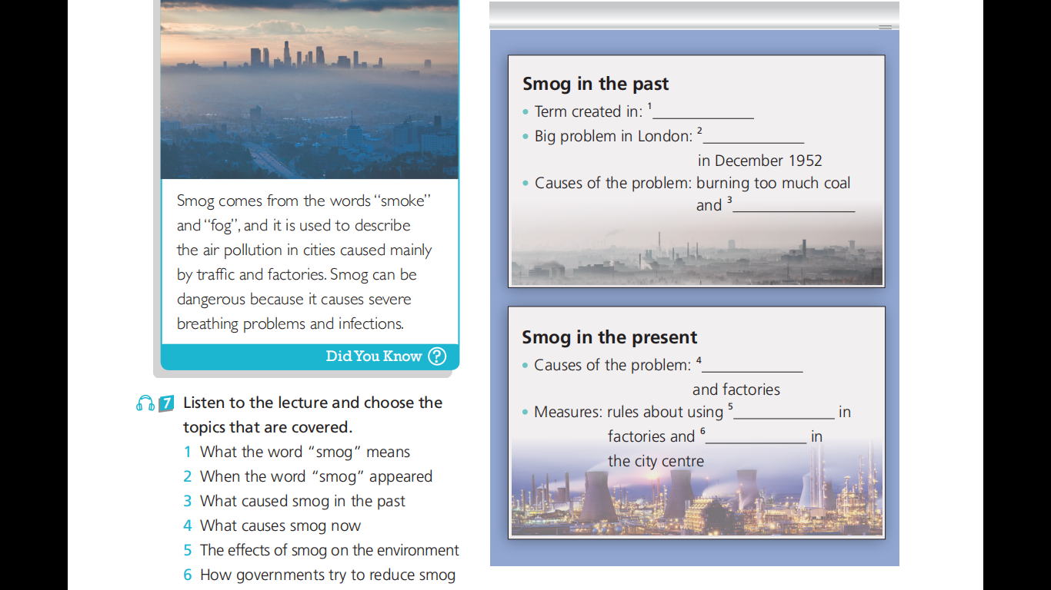
Activity 8
1 1900s
2 The Great Smog
3 no wind
4 chemicals coming from traffic
5 chemicals
6 requirements of paying to drive

Slide 17
听力原文
Lecturer: Good evening, everyone, and thank you for coming to today's talk. I'm Dr Brown and I’m going to talk about air pollution in cities--- what we all know as “smog”. Please feel free to stop me if you have any questions. So, first of all, a bit of history. The term “smog” was first used in the 1800s in cities that had problems with smoke and fog.
Student A: Sorry for interrupting, but I believe it was in the 1900s.
Lecturer: Sorry, I made a mistake. You are right. It was in the 1900s. Thank you.

Slide 18
London was one of the cities where smog caused big problems. In December 1952, it suffered from “ The Great Smog”. It was a very cold winter, so a lot of coal was burned at home and in the factories. The problem was that there was no wind, so thick smog covered the city. Nowadays ...
Student B: Excuse me, but can I just ask--- did the smog cause any deaths?
Lecturer: I'm afraid so. According to research, about 4000 people are known to have died as a result of the smog, but that number could be much higher. It was terrible!

Slide 19
Nowadays, smog will exists, but is produced by chemicals coming from traffic and factories. However, governments are taking measures to reduce smog as much as possible. Now, let's look at what smog does to our health...
Student A: If I could just stop you again... Can you give us examples of these measures?
Lecturer: Well, for example, factories must follow rules about what chemicals they use. In some cities, when there's smog, people have to pay to drive in the centre. Now, let's move on to the impact of smog on our health.

Slide 20
Step 5: Phrases and sentence patterns
1.献身于海洋保护(P65) be devoted to ocean conservation
2.多达50英尺(P65) up to 50 feet
3.旨在强调猎杀海豚的残酷性(P65) aim at highlighting the cruelty of dolphin hunting
4.让更多的人参与到海洋生命的保护中(P65)
get more people involved in the conservation of ocean life
5.自然保护区(P65) nature reserve
6.最重要的是，…(P65) Most importantly, …
7.对……产生负面影响(P65) have a negative impact on

Slide 21
8. carbon footprint(P66)碳足迹(某个时间段内日常活动排放的二氧化碳量)
9.用……替换(P66) replace …with…
10.引发严重的呼吸问题和感染(P67) cause severe breathing problems and infections

