Slide 1
Period 2
Starting Out & Understanding Ideas

Slide 2
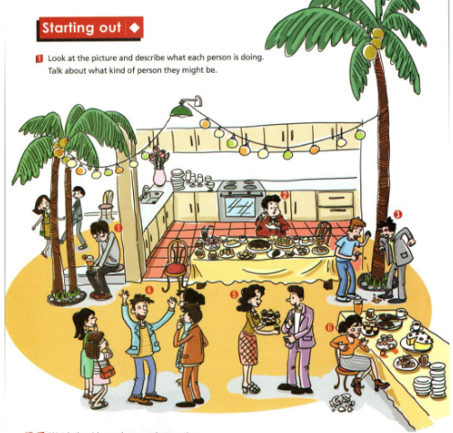
Step 1: Starting Out (Page 1)
Activity 1: Look at the picture and describe what each person is doing. Talk about what kind of person they might be.

Slide 3
Possible answers:
He is sitting alone. He looks disappointed. He may be a quiet person.
He is eager to have/eat food. He may be hungry. It seems that he loves eating.
He is quarrelling with another guy. He looks angry. He may be short-tempered.
He is talking with some people excitedly. He looks delighted. He may be friendly/outgoing.
She is offering cakes to a guy happily. She looks hospitable. She may be a kind girl.
She has broken a cup. She looks frightened. She may be a careless girl.

Slide 4
Activity 2: Watch the video and answer the questions.

Slide 5
Answer the questions：
What do the three conversations have in common?
What would you do in similar situations?
They are all about impolite behaviour in daily life.
In the first situation, I would thank Person 2 for his help without complaining.
In the second situation, I would listen to Person 1 patiently without interrupting.
In the third situation, I would thank Person 2 for the present sincerely without asking how much it is.

Slide 6
Step 2: Before reading
Activity 1: Look at the problems you may face at school. Discuss which you think is the most difficult to overcome and why. Think about who you turn to for help when you face a problem.
bad performance in a subject
pressure to look good
conflict with classmates
difficulties fitting in with others

Slide 7
Now think about who you turn to for help
when you face a problem.
friends
parents
teachers
online forums
no one—you prefer to keep things to yourself
other ________

Slide 8
Step 3: While reading
Task1: Read the letters and find out what kind of problems Ben has and who he turns to for help.
Ben believed one of his teammates let down the whole team and told it to his best friend. But then his friend told everyone else what Ben had said. Now Ben is at a loss for what to do, and he turns to Agony Aunt for help.

Slide 9
Task2: Choose the best summary of the letters.
Ben said something bad about his best friend, and Agony Aunt told him to apologize to his friend.
2. Ben was angry that his team was let down by some
members, and Agony Aunt told him to take it easy.
3. Ben didn’t play well in the match, and Agony Aunt
advised him to apologize to his teammates.
Ben was in an awkward situation, and Agony Aunt
gave him suggestions as to how to deal with his
problems.

Slide 10
Task3: Complete the sentences with expressions
from the passage.
the team were let down
to let off team
went and told everyone else what I’d said

Slide 11
apologize to your teammate
communicating with each other clearly
resolving conflicts
repeating what you said
making the situation worse
say too much
think first, speak later.

Slide 12
Now match the suggestions to Ben's problems.
Suggestion 1--- Problem 1
Suggestion 2--- Problem 3
Suggestion 3--- Problem 2

Slide 13
Think & Share
Task 1: Think about what other advice they would give to Ben?
If you feel awkward to communicate in person, you can write a letter.
Next time do think before you speak though it’s your best friend.
Why not hold a party for his teammates to create a relaxing atmosphere and express his gratitude to play basketball with them.
...

Slide 14
Think & Share
Task 2: Share your opinions about “Loose lips sink ships”.
You may regret saying things without thinking clearly.
Talking too much sometimes may cause a very bad result.
Unguarded talk may give useful information to the enemy.

Slide 15
Task 2: Fill in the blanks. (课文语法填空)
Ben is in an awkward situation and he turns 1. ______ Agony Aunt for help. Ben said that he became very mad because his school basketball team lost a match. He thought that their point guard should be responsible for it. Then Ben told that to his best friend, 2. _______, however, told everyone what he had said. He is in a total mess now, 3. _________ (hope) Agony Aunt can help him out.
to
who
hoping

Slide 16
So Agony Aunt gives Ben some advice. She says that one of the 4. ________ (strategy) to maintain a relationship is clear communication. First, it is a good idea 5. ___________ (apologise) to his teammate. If he wants to win any more basketball games, they need to work together, which means 6. ____________ (communicate) with each other clearly and resolving conflicts. Then, he should talk to his friend. Tell his friend he is mad with him for repeating what he said and making the situation worse, but 7. _______ he wants to move on. 8. _________ (approach) in that way, his friendship will soon be repaired. Thirdly, and perhaps most importantly, Ben should think about his own 9. __________ (behave) and not say too much when he becomes 10. __________ (anger).
strategies
to apologise
communicating
that
Approached
behavio(u)r
angry

Slide 17
Task 3: Learn from the two letters about the basic pattern of asking for help and putting forward suggestions and try to write two letters based on the following sentence patterns.
Sentence patterns to ask for help:
What troubles me most is that...
Facing those problems, I have to turn to you for help.
I wonder if you could do me a favor?/give me a hand?
I would be grateful if you could help me with...
Your kind help would be greatly appreciated.

Slide 18
Sentence patterns to give suggestions:
You should/are supposed to do...
As far as I'm concerned, it would be wise of you to...
Do sth.../ Don't do sth...
You had better (not) do...
Why not do...
How/What about doing...
It's a good idea to...
Only in this way can you....
It would be of benefit to do...
You may/might as well do...

