Slide 1
Period 4
Using Language

Slide 2
Step 1: Lead-in
1.Do Activity 3 on Page 5.
Activity 3:
Influenced Believing Prevented separated realising

Slide 3
Step 2: 透析单元语法（过去分词作状语）
1.过去分词作状语的意义
过去分词作状语，可以表示时间、原因、条件、让步、方式或伴随情况等。过去分词所表示的动作与主语之间构成被动关系；表示被动或完成的动作；分词可位于句首、句中或句末，相当于状语从句。
(1)作时间状语时，相当于when或while等引导的从句。
Eg. Seen from the top of the hill (＝ When it is seen
from the top of the hill), the school looks like a big
garden.

Slide 4
(2)作原因状语时，可转换为because, as或since等引导的从句。
Eg. Encouraged (＝ As she was encouraged) by the teacher, the girl was very happy.
The girl, amazed (＝Because she was amazed) at the sight, didn't know what to say.
区别：Being ill, he was absent from the meeting.
(3)作条件状语时，可转换为once, if或unless等引导的从句。
Eg. Taken according to the directions (＝ If it is taken
according to the directions), the drug has no side effect.
(4)作让步状语时，可转换为though, although或even if等引导的从句。
Eg. Left (＝ Although she was left) alone at home, Jenny didn’t feel afraid at all.

Slide 5
(5)作方式或伴随状语时，常可转换为并列分句。
Eg. Surrounded by his students, the teacher went into the
lab.(＝ The teacher was surrounded by his students and he
went into the lab.)
2. 过去分词作状语时，前面可以带有相应的连词（短语）使表达的意思更明确，如when, until, though, although, as if, as though, even if, if, unless,once等，构成“连词+过去分词”结构，相当于状语从句的省略。除了before和after。
Eg. Even if (I am) invited, I won’t take part in the party.
When (they are) exposed to light, potatoes will turn
green.
Some medicines, if (they are) wrongly taken, can kill a
person.

Slide 6
After being heated (heat), water boils.
Before being interviewed (interview) for the job, you have to take a language test.

Slide 7
4. 形容词化的过去分词作状语
有些动词的过去分词已经形容词化了，在句中作状语时常说明主语存在的状态，如amused, amazed, annoyed, addicted, bored, confused, delighted, disappointed, embarrassed, excited, frightened, interested, impressed, moved, pleased, puzzled, relaxed, satisfied, surprised, shocked, tired, terrified, worried等。
Eg. Grandpa Lin, deeply moved, thanked him again and again.
Frightened, the girl didn’t dare to sleep alone in her room.

Slide 8
2. 单句语法填空
__________(catch) in a heavy rain, he was all wet.
____________(determine) to be admitted into Peking University, he spared no efforts to study hard.
The hunter walked slowly in the forest, ________(follow) by his wolf dog/________ (follow) his wolf dog.
___________(behave) yourself, you will get a nice award.
Einstein walked along the street, ______(lose) in thought/________ himself in thought.
______(equip) with good knowledge, he has a bright future.
___________(remind) not to miss the flight at 15：20, the manager set out for the airport in a hurry.
Not _____________(know) how to operate the machine, they turned to the expert for help.
Caught
Determined
followed
following
Behaving
lost
losing
Equipped
Reminded
knowing

Slide 9
9) ________ (see) from the windows of the classroom, our
school is beautiful.
10) ________(see) from the top of the tower, we can see a
sea of flowers at the south foot of the mountain.
11) _______(devote) to her work/_________ herself to her work, she has no time to travel.
12) _______(lie) still in the grass, he heard the sound of
the wild.
13) _______(attract) by the beauty of nature, the girl from
London decided to spend another two days on the farm.
14) When _______(ask) about it, she could hardly hold
back her tears.
15) The girl met with an accident while __________(cross)
the road, _________(wound) in the head.
Seen
Seeing
Devoted
Devoting
Lying
Attracted
asked
crossing
wounded

Slide 10
solved
16) These problems, if not _________(solve) properly,
will seriously affect the growth of teenagers and even
the nation’s future.
If __________(separate) from his best friends for a
long time, the little boy will feel lonely.
18) Unless ___________(repair), the machine is of no use.
19) Though __________(beat) by the opposite team, the
players were not discouraged.
20) Mary locked herself in her study for the whole
weekend, _________(prepare) for the coming
examination.
21) Greatly ____________(inspire) by what he said, we
are determined to study hard.
separated
repaired
beaten
preparing
inspired

Slide 11
22) ________(drive) by a greater demand for vegetables,
farmers have built more greenhouses.
23) __________(look) back on all those difficult times in the
past, Ivy could not help but let out a sigh.
24) He stood there silently, __________(move) to tears.
25) ____________ in white/___________herself(dress), she looks more beautiful.
26) ___________(expose) to the sunlight, your skin will get burnt.
27) __________(compare) to other problems she was faced
with, this one was not important.
28) _________(face) with /___________a choice between arts and science, the little girl didn’t know which to choose.
29) ___________(offer) an important role in the movie, Andy has got a chance to become famous.
30) _________________________________(catch) in the rain, my daughter....
Driven
Looking
moved
Dressed
Dressing
Exposed
Compared
Faced
Facing
Offered
Caught/Having been caught

Slide 12
3. 用分词作状语的方式翻译下列句子
我和父亲正坐在桌旁讨论着我的工作问题。
2) 面对困难，我们必须设法克服。
3) 由于对他所做的事情很满意，老师在课堂上表扬了他。
Seating themselves /Seated at the table, my father and I were talking about my job.
Faced with/Facing difficulties, we must try to overcome them
Satisfied with what he did, the teacher praised him
in class.

Slide 13
4)在大学舍友的陪同(accompany)下，他参观了西安的许多名胜古迹。
5)受他的影响，越来越多的人喜欢上了户外活动。
8)泰山位于山东省，一直是旅行景点，有许多传奇故事与之相关。
9)如果多给这个男孩一些鼓励，他本能够表现得更好。
10)如果经常进行适量的运动的话，就能改善我们的健康状况。
Accompanied by his university roommates, he visited
many places of interest in Xi’an.
Influenced by him, more and more people fell in love
with outdoor activities.
Located in Shandong province, Mount Tai has been a tourist attraction, with many Chinese lengendary stories attached to it .
Given more encouragement, the boy could have behaved better.
Proper amounts of exercise, (if) carried out regularly, can improve our health.

Slide 14
Step 3: Vocabulary & Listening
Activity4: Read the tips and underline the words that describe behavior towards others.

Slide 15
Activity 5：Describe the situations with the words you
underlined in Activity 4.
I’m really sorry. I didn’t mean it.
You’re so selfish!
I know you’re sorry. It’s OK. Don’t worry about it.
I can tell he is not easy to get along with.
I don’t want to wait for him all the time.
My pet parrot flew away with my homework.
apologise
criticise
forgive
judge
complain
lie

Slide 16
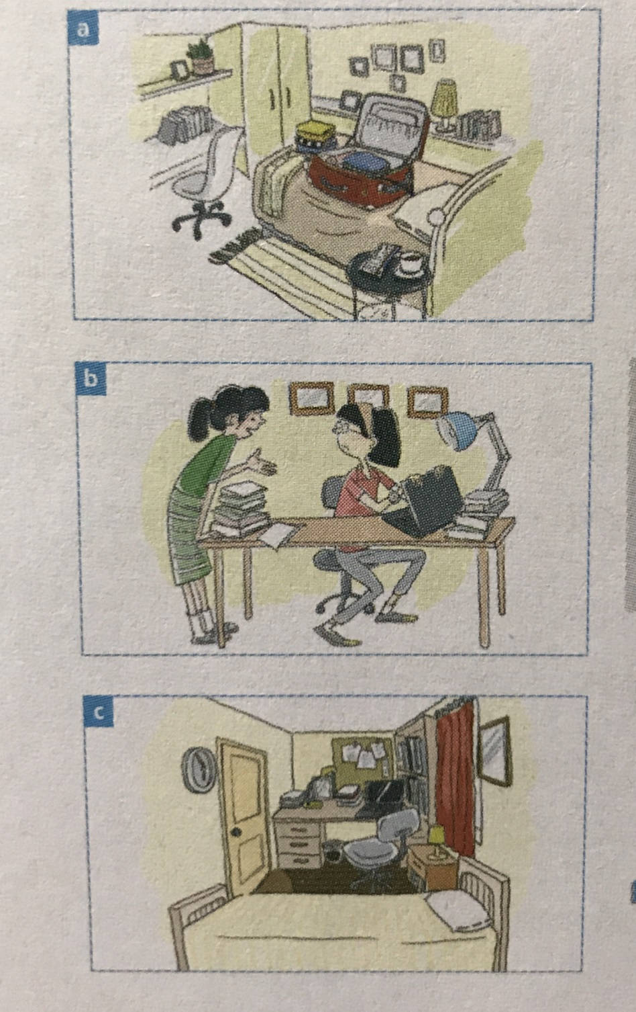
Activity 7: Listen to three conversations and match them to the pictures.
Conversation 2
Conversation 3
Conversation 1

Slide 17
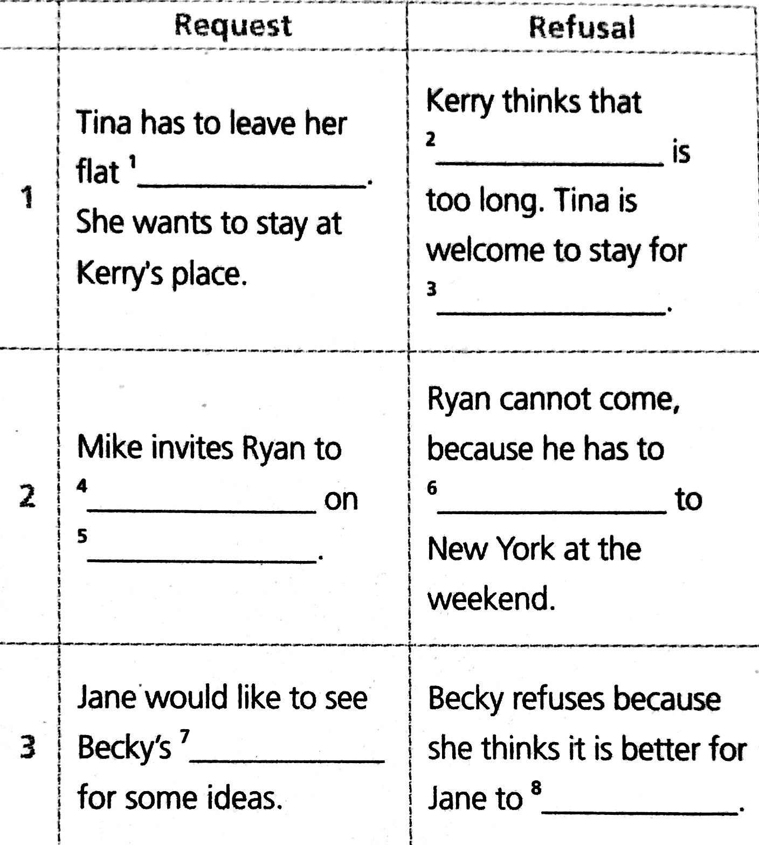
Activity 8: Listen again and complete the table.
one month
next week
a few days
come to the party
prepare for the trip
Saturday
project
do her project by herself

Slide 18
Conversation 1
Tina: Hi Kerry, have you got a minute?
Kerry: Yeah, sure, Tina. What’s up?
Tina: Well, the thing is, I've got to leave my flat next week, but my new place won't be ready
until next month. Could I stay at your place for a while?
Kerry: You mean for a couple of days?
Tina: Er... not exactly. For a month.
Kerry: A month? I’m afraid one month is just too long.
Tina: Oh, come on, please...
Kerry: I'm sorry, but my room is just too small for two people. You're welcome to stay for a few days, though.

Slide 19
Conversation 2
Mike: Hello Ryan! Just the person I wanted to see!
Ryan: Hi Mike. How’s it going?
Mike: I'm having a party at my house on Saturday. You'll
come, won't you?
Ryan: On Saturday? I'd love to, but I'm visiting my cousin
in New York on Monday, and
I have to spend the weekend preparing for the trip.
Mike: That's too bad. I'm sorry you'll miss it.
Ryan: Yes, I'm sorry, too. Next time, OK?

Slide 20
Conversation 3
Jane: Becky, have you done your project yet?
Becky: Hi Jane. You mean the one that's due tomorrow?
Jane: Yes, that's the one.
Becky: Of course I have. Haven't you finished yours yet?
Jane: No, I haven't. The thing is, I've been really busy
and... Well, I was just wondering if
you could let me see your project, just to give me some
ideas, you know...
Becky: I'm not sure... It would be better to do your project by yourself.
Jane: I promise I won't copy it or anything like that.
Becky: I'm sorry, Jane, it just doesn't feel right. I'd be
happy to talk about your project with
\you, though, if you need my help.

Slide 21
Step 4: Important phrases in using language
代替某人/某物；而不是某人/某物 (P5)
对某人/某物满意 (P5)
保持沉默 (P5)
取得领先地位 (P5)
阻止某人/某物做某事 (P5)
适应新环境有困难 (P5)
instead of sb./ sth
be satisfied with sb./ sth.
keep silent
take the lead
prevent sb./ sth. from doing sth
have a hard time adjusting to the new surroundings

Slide 22
7. 与某人分离 (P5)
8. 从...逃跑；逃避... (P5)
9. 处理成长中复杂的情感问 题 (P5)
10. 安定下来；安静下来 (P5)
11. (向某人)抱怨某人/某 (P6)
12. 对事物抱乐观态度；往好处想 (P6)
13. 一直，始终 (P6)
be separated from sb.
run away from...
deal with the emotional
complexity of growing up
settle down
complain (to sb.) about
/ of sb./ sth
look on the bright side
all the time

