Slide 1
Period 5
Developing Ideas & Presenting Ideas

Slide 2
Step 1: Developing Ideas
Task 1: Deal with Activity 1 on Page 8.
Look at the pictures. What would you say if you were student B?
Possible answers:
B: Oh, sorry to hear that. But I did no better than you.
B: Come on. Actually you did well. I did worse than you.
B: Well, I did just so-so.

Slide 3
Activity 2
Task 2:
Read the passage and find out the meaning of “white lies”.
little lies that we tell to protect others from bad news
little lies that we tell to make others feel better
little lies that we tell to give encouragement
White lies are little lies that we tell to protect others from the truth.

Slide 4
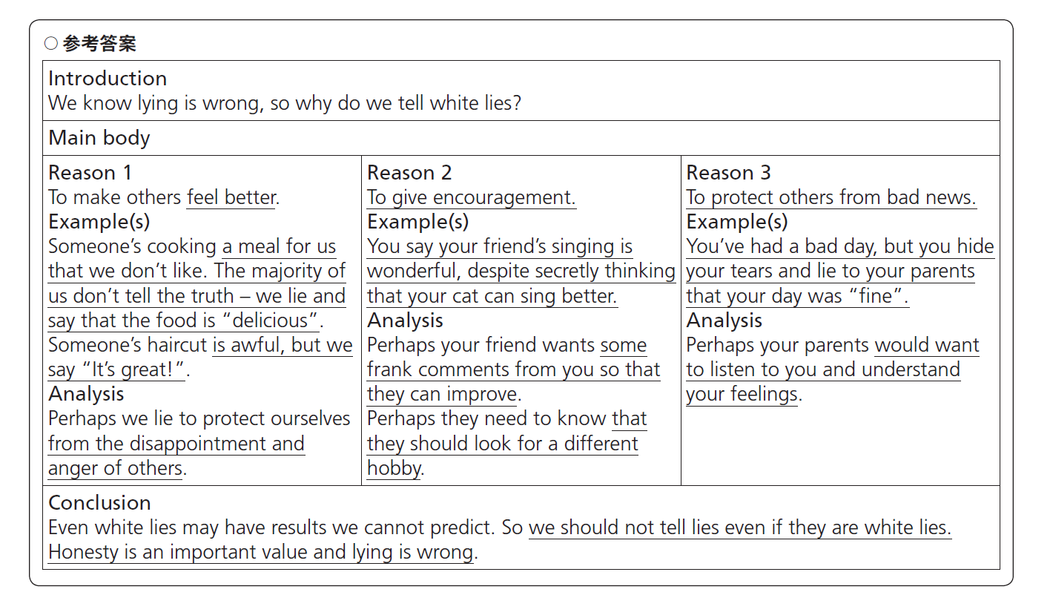
Activity3：Complete the diagram with the
information from the passage.

Slide 5
Task 3: Read the passage again and answer the questions.
1 What does the “web” in the poem represent?
It represents a complicated situation, in which once we tell a lie, we have to continue to tell more other lies in order to cover the previous ones.

Slide 6
2 What do you think is the difference between a lie and a white lie?
A lie is told to cover the truth in order to benefit yourself, which can be harmful to others. A white lie is told to avoid hurting others, without bad intention.

Slide 7
Step 2: Useful expressions and sentence patterns
protect sb./ sth. from
(doing) sth.
保护某人/某物免受...伤害
征求某人的建议
向某人隐瞒真相
由三部分组成/构成 (P10)
一系列的 (P10)
把A和B.联系起来 (P10)
根据...改编 (P11)
分开，移开 (P11)
总之，最后 (P11)
ask for one’s advice
hide the truth from sb.
consist of three parts
= be made up of three parts
a series of
link A to B
be adapted from...
move apart
in conclusion

Slide 8
Written
10. _________ (write) more than two hundred years ago, these lines ____Walter Scott remain one of the most well-known ________(excerpt) of Scottish poetry.
11. We all know that ________(honest) is an important value and ________lying is wrong, but who can __________(honest) say that they’ve never told a lie?
12. Or if a friend asks us _______we think of their new haircut, we say “It’s great!”, even __we think it’s awful.
13. One of the main reasons _____telling a white lie is ________(try) to make others feel ________(good).
14. Perhaps we are in fact _______(lie) to protect __________(we) from the _______________(disappoint) and anger of others.
by
excerpts
honesty
that
honestly
what
if
for
to try
better
lying
ourselves
disappointment

Slide 9
to
telling
15. But ___ what extent can we justify ______ (tell) white lies like these?
【翻译】___________________________________
___________________________________________
But we seldom realize the extent to which English has influenced every corner of our lives.
但是，我们很少意识到的是，英语影响到我们生活的每个角落的程度。
16. Moreover, how would you feel if you discovered that the people closest ___ you __________________(hide) the truth _______you?
【翻译】___________________________________
___________________________________________
但是我们能在多大程度上为这些善意的谎言辩解呢？
to
had been hiding
from
而且，如果你发现你最亲近的人一直向你隐瞒事实，你会感觉如何？

Slide 10
【练一练】
1) 如果我是你，我会抓住这次出国的机会。
2) 如果我有更多的时间，我就会帮你学英语了。
If I were you, I would take/ seize the
opportunity to go abroad.
If I had more time, I would help you with your English.

Slide 11
more independent
17. The _____________________(independent) you are, the better your life will be. (P11)
【翻译】___________________________________
【分析】本句为“the + 比较级，the + 比较级”结构，表示“越..., 就越...”。
【练一练】
1) 你说英语越多，你的英语就会越好。
____________________________________________
____________________________________________
2) 汽车的动力越大，就越难操纵(handle)。
___________________________________________
___________________________________________
你越独立，你的生活就会越好。
The more you speak English, the better
your English will become.
The more powerful the car is, the more
difficult it is to handle.

Slide 12
Step 3: Presenting ideas
Translate the following sentences. (P12)
1. 己所不欲勿施于人。
Do not do to others what you do not want others to do to you.
2.有了好篱笆才有好邻居。
Good fences make good neighbors.
3. The most basic of all human needs is the need to understand and be understood.
人类最基本的需求就是理解和被理解。

Slide 13
Step 4: Writing
Activity5: Read the fable on Page 11 and choose the message you think it conveys. (Page 11, Activity 5)
1. Porcupines are not social animals.
2. The more independent you are, the better your life will be.
3. There should be boundaries in interpersonal relationships.

Slide 14
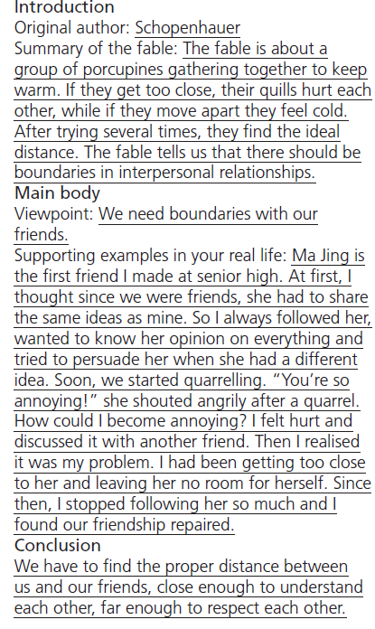
Activity6: Make notes based on the passage “The Porcupine Dilemma” with your own opinions and write an essay using the expressions in the box on page 11 to help you.

Slide 15
【如何写议论文】
议论文是一种剖析事物、论述事理、发表意见、提出主张的文体。议论文要求文章必须逻辑严密，结构清晰，一般分为三部分：
第一部分：引言(Introduction)
在引言段中作者须简单解释要讨论的问题。开头可以有一个导语引出要讨论的问题——可以是名人名言，也可以是一个问题；如果是就一篇文章进行讨论，就要概括文章内容。
第二部分：主体(Main body)
提出论点；然后给一个例子或者是引用能支持论点的材料进行阐述。
第三部分：结论(Conclusion)
结论段可以用一两句话来深化主题、结束文章。

Slide 16
【增分表达】
1．引言常用表达
(1) Nowadays more and more people...
(2) ...play an important part in...
(3) Like everything else, ...has/have both favorable and unfavorable aspects/ both advantages and disadvantages.
(4) Generally speaking, the favorable aspects/ advantages can be listed as follows.

Slide 17
2．主体常用表达
(1) Firstly, ... Secondly, ... In addition/ Furthermore/ Moreover/ What’s more, ...
(2) Every coin has two sides.
(3) The negative aspects/ disadvantages are also apparent/ obvious.
(4) To begin with, ... To make matters worse, ... Worse still, ...
3．结论常用表达
Through above analysis/ All things considered, we can see that the positive aspects/ advantages outweigh the negative ones/ disadvantages. Therefore, ...

Slide 18
【相关主题例文赏析】
假如你是李华，英语课上，你班就“A friend in need is a friend indeed.”这一主题展开讨论，请你写一篇英语文章，谈谈自己对友情的看法。内容要点包括：
自己对这句话的理解；
介绍自己的一次经历。
注意：1. 词数100左右；2. 可以适当增加细节，以使行文连贯。

Slide 19
It’s universally acknowledged that (大家普遍认为）friendship is one of the greatest pleasures that people can enjoy. A good friend can always get us through the hard times （使我们渡过难关）and point out our mistakes without laughing at us. When getting into trouble（当遇到困难）, we need friends to offer us help, support and encouragement. With success achieved, we also need friends to share our joy (取得成功时，我们也需要朋友来分享我们的快乐).

Slide 20
As the saying goes, a friend in need is a friend indeed （正如谚语所说，患难见真情）. I have a better understanding of （我更好地理解）this proverb from my own experience. In the past, so poor was my oral English that I was laughed at whenever I spoke English（我的口语如此差劲以至于每当我讲英语的时候都被取笑）. I lost face and felt down, losing interest in learning English（失去学习英语的兴趣） . It was Li Lei who encouraged me and helped me practice English. Without his help, I couldn’t have cheered up. （要不是他的帮助，我不会振作起来）Therefore, I hold a firm belief that（我坚信) our life will become better if we have several true friends.
In conclusion (总之) , friendship is our treasure. I will try my best to value it by helping friends when they are in need.

