Slide 1
Period 4 Using Language & Listening

Slide 2
Step 1 Look at the pictures of the three people on Page 13, read the quotations and finish the following sentences.
1. The amount of relief and comfort (experience) by the sick after the skin has been carefully washed and dried, is one of the commonest observations ____________(make) at a sick bed.
2. There is nobody (hurt), and the well’s under control.
experienced
made
hurt

Slide 3
Step 2 -ed as attribute （过去分词作定语）
单元语法透析
过去分词作定语，性质上相当于形容词，其逻辑主语就是它所修饰的名词或代词。它所
修饰的名词、代词与之构成被动关系。
过去分词作定语的位置：
单个的过去分词作定语时，常常置于所修饰的名词前，叫做前置定语；而过去分词短语作定语时，常常置于其所修饰的名词之后，叫做后置定语。
Your (speak) English is quite good.
Taking exercise early in the morning has become a part of his ___________(retire) life.
Would you like to explain in detail the problems (mention) in this chapter?
spoken
retired
mentioned

Slide 4
过去分词修饰something/everything/anything/nothing/somebody/nobody等不定代词以及指示代词those时，要放在这些词的后面。
He is one of those (invite).
Nothing (report) in the newspaper interested him.
过去分词作定语的意义：
及物动词的过去分词作定语，可以表被动，也可以表被动+完成。
She is a (respect) teacher.
The question (discuss) yesterday remains up in the air.
Did you accept the invitation (give) by the tour guide?
We'll go on with our experiment as soon as we get the (add) fund.
invited
reported
respected
discussed
given
added

Slide 5
不及物动词的过去分词作定语时，一般是前置定语，不表示被动，强调动作完成。如：fallen, retired, risen, escaped, arrived, dated, faded等。
We can see the (fall) leaves everywhere on the ground.
Can you tell me why the rising sun looks much bigger than the _________(rise) sun?
有些动词的过去分词已经转化成形容词，多用来表示人物的心理特征或感情变化。常见的有：disappointed，surprised，puzzled，frightened，moved，shocked，confused，embarrassed，satisfied等。
He threw me a quick and (puzzle) glance.
I know he didn’t pass the examination from his (disappoint) look.
The teacher is comforting the (frighten) girl.
fallen
risen
puzzled
disappointed
frightened

Slide 6
当过去分词或过去分词短语作定语时，往往可以用定语从句代替。
1) All the leaves __________have been cleared away.
=All the fallen leaves have been cleared away.
2) Most of the guests to the party were my classmates.
=Most of the guests invited to the party were my classmates.
3) I am fond of the food by my mother.
=I am fond of the food cooked by my mother.
4) The government decided to rebuild the bridge_______________________
=The government decided to rebuild the damaged bridge.
that fell
who were invited
that/which is cooked
that/which has been damaged.

Slide 7
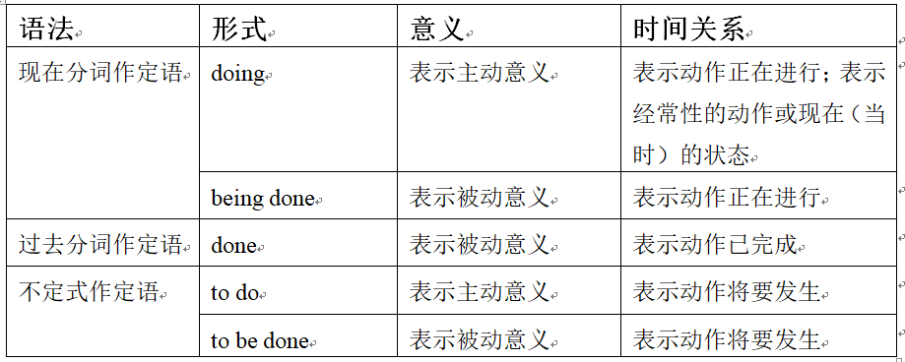
现在分词、过去分词和不定式作定语的区别
to be discussed
The problem (discuss) at the meeting tomorrow is of great importance. (表示动作将要发生)
The problem (discuss) at the meeting now is of great importance. (表示动作正在进行)
The problem (discuss) at the meeting yesterday is of great importance. (表示动作已完成)
being discussed
discussed

Slide 8
Step 3 Exercises
Exercise 1 Finish Activity 2&3 on Page 17.
Exercise 2 Choose the best answer.
1. There have been several new events _____ to the program for the 2008 Beijing Olympic Games.
A. add B. to add C. adding D. added
2. Five people won the “China’s Green Figure” award, a title ___________ to ordinary people for their contributions to environmental protection.
being given B. is given C. given D. was given
D
C
B
3. Prices of daily goods ___________ through a computer can be lower than store prices.
A. are bought B. bought C. been bought D. buying

Slide 9
4. Don’t use words, expressions, or phrases ___________ only to people with specific knowledge.
A. being known B. having been known C. to be known D. known
5. The prize of the game show is $ 30,000 and an all expenses-___________ vacation to China.
paying B. paid C. to be paid D. being paid
D
B
6. The disco, digitally ___________ in the studio, sounded fantastic at the party that night.
A. recorded B. recording C. to be recorded D. having recorded
7. Most of the artists ___________ to the party were from South Africa.
A. invited B. to invite C. being invited D. had been invited
A
A

Slide 10
8. The repairs cost a lot, but it’s money well ___________.
A. to spend B. spent C. being spent D. spending
9. The producer comes regularly to collect the cameras_________ to our shop for quality problems
returning B. returned C. to return D. to be returned 10. The first textbook ____ for teaching English as a foreign language came out in the 16th century. A. have written B. to be written C. being written D. written 11. The trees ___________ in the storm have been moved off the road by the cleaners. A. being blown down B. blown down C. blowing down D. to blow down
B
D
B

Slide 11
12. The Town Hall _________ in the 1800s was the most distinguished building at that time.
A. to be completed B. having been completed C. completed D. being completed
13. The girl ________ in blue skirt laughs like a blossoming flower.
dressed B. dressing C. to dress D. is dressed
C
A
14. We phoned the police and they said they would come soon to take away the _________ car.
A. damaging B. damaged C. to be damaged D. being damaged
15. When he hurried back to get his luggage, he found there was nothing __________ at the station.
A. leaving B. being left C. left D. to leave
B
C

Slide 12
16. “Things __________ never come again!” I couldn’t help talking to myself.
A. losing B. to lose C. lost D. lose
17. The house _________ south belongs to Mr. Smith, who is a poor but kind old man.
faced B. facing C. to face D. being faced
C
B
Exercise 3 单句语法填空
1. The money (raise) at the evening will be sent to the earthquake survivors as soon as possible.
2. Youth, (direct) by Feng Xiaogang, was released in December, 2017.
raised
directed

Slide 13
3. There is a black car (park) in the yard by which Mr. White usually goes to work.
4. Tim’s (puzzle) expression suggested that he didn’t understand what they had said.
5. I was the first Western TV reporter (permit) to film a special unit caring for pandas rescued from starvation in the wild.
6. The yoga club, (open) last month in our school, is popular among women teachers. 7. It regularly arranges quick getaways here for people ____________(live) in Shanghai and Hong Kong.
parked
puzzled
permitted
opened
living

Slide 14
8. The adobe dwellings (土坯房) (build) by the Pueblo Indians of the American Southwest are admired by even the most modern architects and engineers.
9. A study of travelers (conduct) by the website TripAdvisor names Yangshuo as one of the top 10 destinations in the world.
10. The weather of Zibo (change) dramatically within one day has led me to a severe cold.
11. “Don’t travel during the holidays” is one golden rule ____________(follow) by some friends for years, especially during the Spring Festival as the traffic is heavy.
12. In the beginning, a senior man (name) Li Yubao in a remote mountainous area asked his grandson on the phone what gift he wanted for the Spring Festival.
built
conducted
changing
followed
named

Slide 15
13. The class centered round why the body needs to sleep and the physical and mental health problems ____________(cause) by a lack of sleep.
14. We are brothers (share) weal and woe(福祸).
15. In art criticism, you must assume the artist have a secret message (hide) within the work.
16. The (break) dishes lay on the floor.
17. In the research (involve) about 200 people, the blood test found early stages of melanoma (黑素瘤) in more than 80 percent of cases.
18. China stretches across a vast area (cover) the cold, temperate and tropical zones.
19. The (injury) workers are now being taken good care of in the hospital.
caused
sharing
hidden
broken
involving
covering
injured

Slide 16
20. There are many beautifully (decorate) houses in this rich area.
21. Lying on the (fall) leaves and looking at the white clouds in the sky, we felt really relaxed.
22. There are many people (stand) at the crossroad, hesitating.
23. Earth Day, (mark) on 22 April, is an annual event aiming to raise public awareness
about environmental protection.
24. There are five pairs (choose), but I’m at a loss which to choose.
25. The landing is an example of China’s growing desire ______________(compete) with the American, Russian and European space programs.
decorated
fallen
standing
marked
to choose from
to compete

Slide 17
Exercise 4 用分词作定语的方式翻译以下句子
1.有200幅优秀的绘画作品在展览上展出。(there be句型)
2. 听说您对中国武术(Chinese Martial Art)有极大的热情，并渴望了解更多，我迫不及待地通知您我们俱乐部将举办一场功夫表演。
3. 他是一位受所有学生尊敬的语言学教授。(respect)
There were 200 excellent paintings shown on the exhibition.
Hearing you have a great passion for Chinese Martial Art and are eager to know more about it, I can’t wait to inform you of a kung fu show to be held by our club.
He is a professor of linguistics respected by all the students.

Slide 18
4. 正在给队员鼓气的这个男人是这次活动的组织者。(cheer up) 5.这家快递公司承诺在线上购买的物品24小时内可以送达。
Step 4 Listening
Personal qualities
Finish Activity 4 and 5 on Page 18.
The man cheering up the team members is the organiz(s)er of this activity.
The express company promised that the items bought online can be delivered in 24 hours.

Slide 19
Keys: Activity 4: Liu Tao: sensitive, serious, bookish, independent Li Mei: shy, generous, honest Tim: confident, nervous, creative Anna: easygoing, lazy Activity 5: Positive: independent, generous, honest, confident, creative, easygoing, loyal, intelligent, determined, warm-hearted, straightforward…
Neutral: sensitive, serious, bookish, shy, self-conscious, strict
Negative: nervous, lazy, short-sighted, selfish, mean, slack…

Slide 20
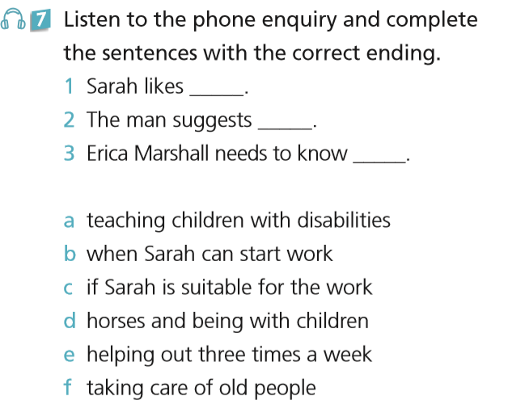
Listening---To be a volunteer Task 1 listen to the tape and finish Activity 7 on Page 19.
d
a
c

Slide 21
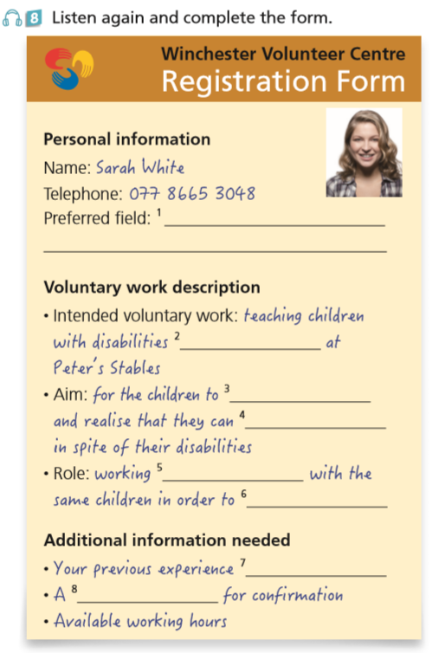
working with children / some kind of youth work
riding horse
have fun
still enjoy sports
one on one
build a relationship with them
as a volunteer
reference from someone who knows you
Task 3 Work in pairs. Act out a telephone enquiry.
Notes:
开始，设计，页面，尺寸：50.8 28.58

Slide 22
听力文本：
Danny: Winchester Volunteer Centre. How can I help you?
Sarah: Hi, yes, my name is Sarah White and I’m interested in doing some sort of voluntary
work. Could you tell me how to become a volunteer?
Danny: Of course. OK, so, first of all, you need to think about what type of work you would like to do. Any ideas?
Sarah: Well... I enjoy working with children, so maybe some work of this kind.
Danny: OK. Let's see. Do you do any sports at all?
Sarah: Yes, I've been riding since I was little. I really love horses.

Slide 23
Danny: Well, they do riding classes for kids with disabilities at Peter's Stables. Perhaps that
would interest you.
Sarah: Oh, that sounds interesting. Can you tell me a bit more about it?
Danny: The most important thing is for the children to have fun and learn that they can still
enjoy sports despite their disabilities. You work one on one with the same children each
week, so you get to build a relationship with them. It's amazing to see how their
confidence increases over time.

Slide 24
Sarah: That sounds just right for me! What should I do to get the work?
Danny: You can call Mrs. Erica Marshall, director of the Stables. Her number is 0738695 2054.
Sarah: OK. Is there anything else I need to know?
Danny: Once you've contacted Mrs. Marshall, she'll want to know if you have previous experience as a volunteer. She'll probably also want a reference from someone who knows you, just to make sure that you're the right sort of person for that kind of work. And then, of course, you should think about how often you would like to help out.
Sarah: Right. That all sounds great. I'll prepare the information needed and call her. Thank you very much.

Slide 25
Step 5 Phrases and sentence patterns
承担使命 (P17)
犹豫做某事 (P18)
在某件事上相信某人 (P18)
对……有信心 (P18)
想出好主意 (P18)
幽默感 (P18)
使某人高兴/振作起来 (P18)
在环境保护中扮演日益重要的角色
(P19)
take up the mission
hesitate to do sth.
trust sb. with sth.
be confident about
come up with good ideas
a sense of humor
cheer sb up
play an increasingly important role in environmental protection

