Slide 1
Period 5 Using Language (Ⅱ)

Slide 2
Careers in science
Look at the pictures and answer the questions.
1. What do you know about these careers?
A physicist is a person who does research connected with physics or who studies physics.
physicist

Slide 3
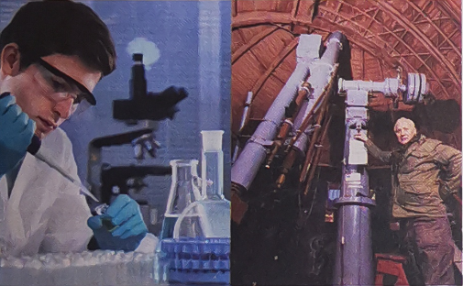
A mathematician is a person who is trained to the study of numbers and calculations.
mathematician
A chemist is a person who does research connected with chemistry or who studies chemistry.
chemist

Slide 4
An astronomer is a scientist who studies the stars, planets and other natural objects in space.
astronomer
A geographer is a person who studies geography or is an expert in it.
geographer

Slide 5
A biologist is a person who studies or works in the field of biology
biologist

Slide 6
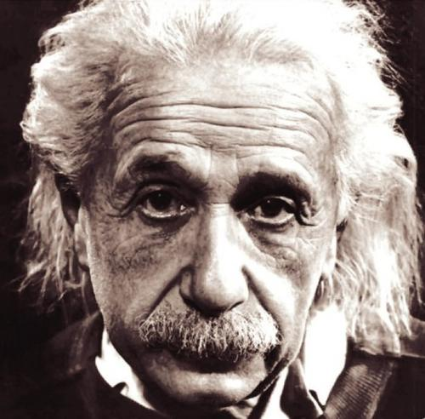
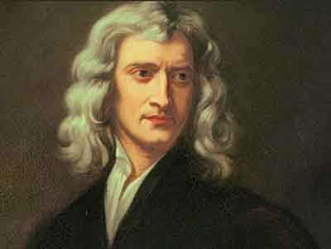
2. What famous scientists can you name in these fields?
physicist
Albert Einstein
Isaac Newton

Slide 7
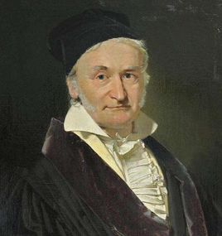
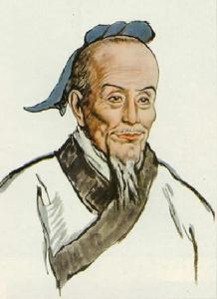
mathematician
Johann Carl Friedrich Gauss
Zu Chongzhi

Slide 8
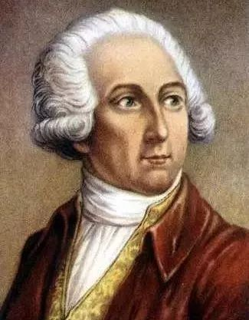
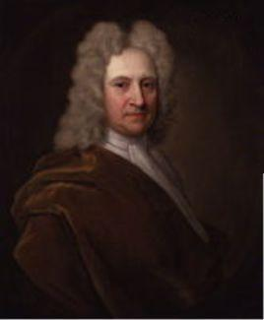
chemist
astronomer
Antoine-Laurent de Lavoisier
Edmond Halley

Slide 9
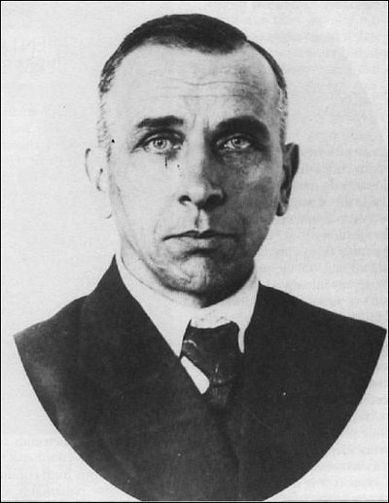
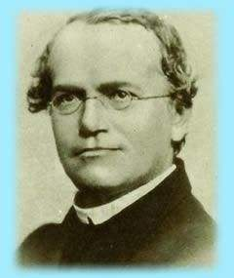
geographer
biologist
Alfred Lothar Wegener
Gregor Johann Mendel

Slide 10
Complete the introductions about different scientists with the words in Activity 4. Pay attention to the language that describes their careers.

Slide 11
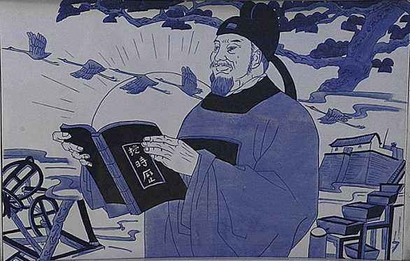
Guo Shoujing (1231-1316) was a famous Chinese ___________ of the Yuan Dynasty. He invented twelve new instruments to study stars and planets. He also developed a calendar which is as accurate as the Gregorian calendar. A mountain on the Moon and a minor planet are named after him.
astronomer

Slide 12
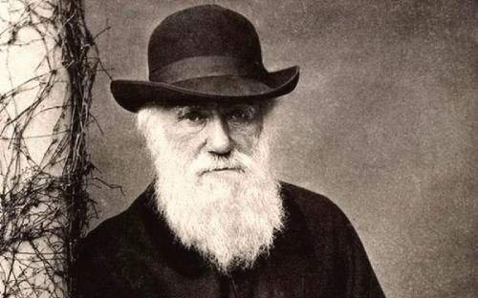
British ________ Charles Darwin (1809-1882) is best known for his work On the origin of Species, in which he explains changes in species due to natural selection. His ideas deeply influence our understanding of the relationship between humans and nature.
biologist

Slide 13
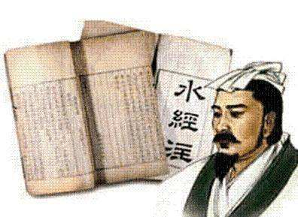
Li Daoyuan (ca 466-527) was a famous writer and ___________ of the Northern Wei Dynasty. He did field research across China and studied more than a thousand rivers and streams, along with the landscape, history and culture of the surrounding areas.
geographer

Slide 14
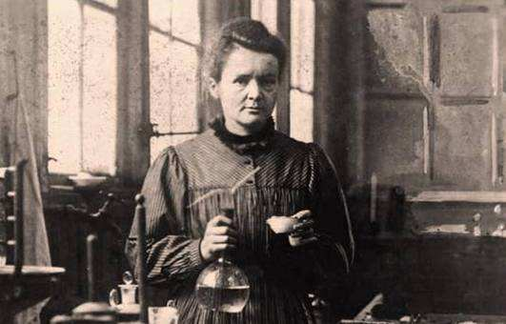
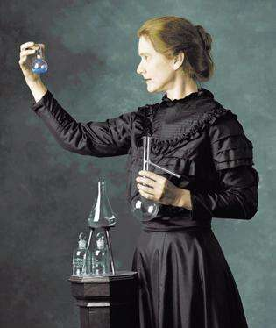
Marie Curie (1867-1934) was a world –famous ________ and was first awarded the Nobel Prize in 1903 for her extraordinary work on radioactivity. She was also regarded as a brilliant _________, and was again awarded the Nobel Prize in 1911 for the isolation of pure radium.
chemist
physicist

Slide 15
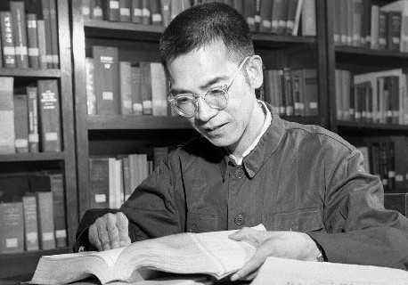
Chen Jingrun (1933-1996) was one of the world’s leading _______________. His work on Chen’s Theorem made an important advance towards proving Goldbach’s Conjecture, the greatest unsolved problem in number theory.
mathematician

Slide 16
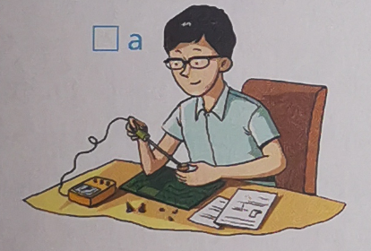
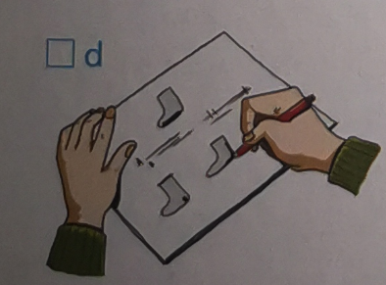
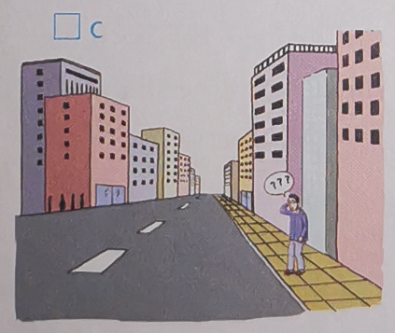
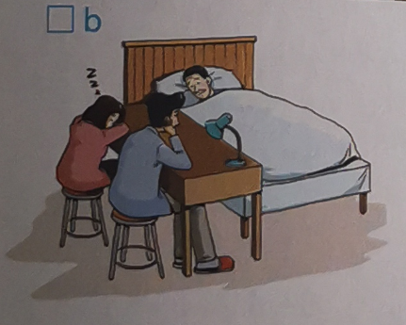
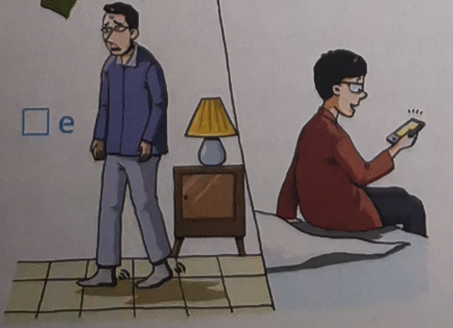
2. Read “Did You Know” on Page 31, listen to the record and do Activity 7&8 on Page 31.
Listen to the conversation and number the pictures in the correct order.
c b d a e

Slide 17
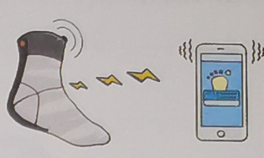
Listen again and complete the notes.
What is it?
a pair of socks designed
for people with Alzheimer’s disease.
It’s________________.
Who was it invented by?
a student form New York
It was invented by____________________
called Kenneth.

Slide 18
Who inspired the invention?
His grandfather
__________________, who has Alzheimer's.
How does it work?
A warning
__________________ is sent to a mobile phone like an alarm when the person with it ____________________.
gets out of bed

Slide 19
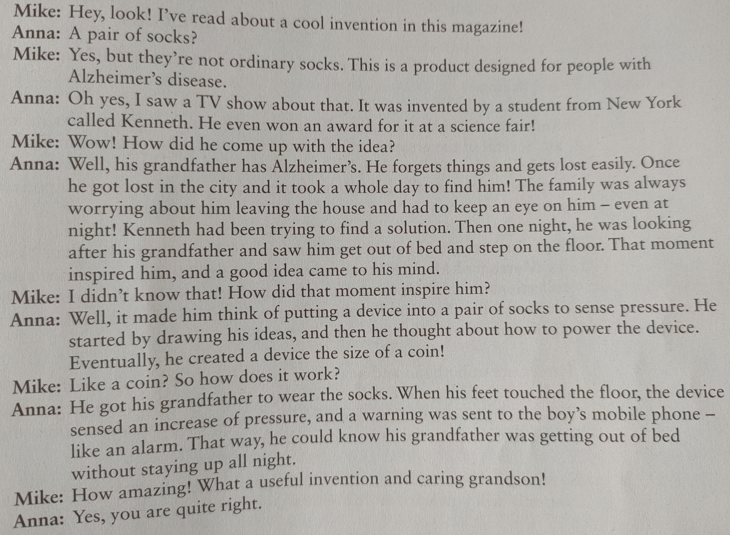

Slide 20
Step 3: Important phrases in using language
无法辨认；面目全非
取得成功
直到现在
闯入实验室
制定一种历法
以A命名B
认为…是…/称…为…
颁给某人诺贝尔奖
由于自然选择
实地研究，实地调研
被认为是……
改善生活质量
无药可治
beyond recognition (P29)
achieve success(P29)
to date (P29)
break into the lab(P29)
develop a calendar (P30)
name B after A(P30)
regard…as… (P30)
award sb. the Noble Prize (P30)
due to natural selection(P30)
field research(P30)
be recognized as… (P31)
improve the quality of life (P31)
There is no cure for...(P31)

Slide 21
哥德巴赫猜想
纯镭的隔离提取
数论
格里历，阳历
Goldbach’s Conjecture (P30)
the isolation of pure radium
number theory
Gregorian calendar(P30)

