Slide 1
Period 6
Developing Ideas & Presenting Ideas

Slide 2
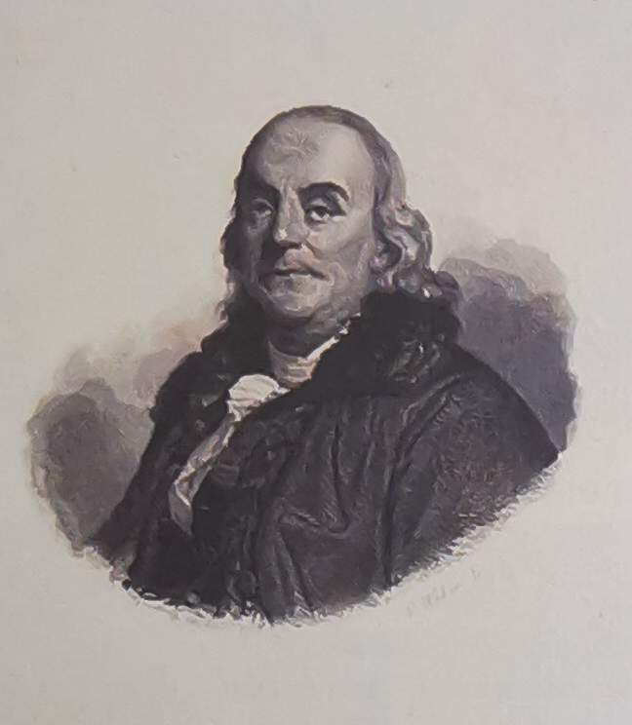
1. Read the short introduction to Benjamin Franklin and share any other information you know about him?
Benjamin Franklin(1706-1790)was one of the Founding Fathers of the United States and helped draft the Declaration of Independence. Apart from being a successful statesman, he was also well known as a leading American author, printer and publisher, successful diplomat, creative scientist and inventor.

Slide 3
Read the passage and find out what
Franklin’s experiment aimed to prove.
Franklin’s experiment aimed to prove that lightning was a form of electricity.

Slide 4
Number the statements to show how
people's attitudes towards Franklin's
experiment have changed.
Franklin’s spirit of scientific
exploration is still considered an
inspiration.
People are amazed at and inspired by
Franklin’s experiment.
Scientists question what really
happened in Franklin’s experiment.
3
1
2

Slide 5
1) Do you think it matters that Franklin’s
experiment might not be true? Why?
eg No. Because what really matters lies in
his bravery to do the experiment.
2) What is your opinion about the statement
"…we should not always believe everything
we read or hear - even if it is a great story"?
eg Sometimes a really great story may be
not true, and we need to have critical
thinking.

Slide 6
3) What qualities do you think a great scientist
should have?
e.g. I think a great scientist should be
patient, serious, brave, careful, creative
and imaginative…

Slide 7
4) In what ways do scientists contribute to
society?
Firstly , scientific discoveries promote the development of our society.
Secondly, the contributions of scientists in medicine extend our life span.
Thirdly, scientists have invented a lot of surprising tools that fundamentally improve our living standards.

Slide 8
Step 2: Useful expressions and sentence patterns
1.Founding Father
2.Declaration of Independence
3.introduce generations of children to science
4.a flash of lightning
5.get an electric shock
6.establish the truth
7.contribute towards scientific discoveries andinventions
8.establish the facts
9.放风筝
缔造者，开国元勋
独立宣言
向一代又一代的孩子们介绍科学
一道闪电
触电
寻求事实真相
促进科学发现和发明创造
查证事实
fly a kite

Slide 9
10. 将某物系在某物上
11. 寻求事实的方法
12. 发生
13. 引领他提出万有引力定律
14. 区别：a falling apple
落地的苹果
15. 敲打他的头
16. 科研探索的精神
tie/attach sth. to sth.
the/an approach to looking for the truth
take place
lead him to come up with his theory of gravity
正落下的苹果/
a fallen apple
hit him on the head
spirit of scientific exploration

Slide 10
17. Apart from ______(be) a successful statesman, he was also well known ______ a leading American author…
【翻译】他不仅是一位成功的政治家，还被称为美国著名的领军作家…
【分析】apart from:除…外(=except for, except); 除…之外还有…(= besides),其后常跟名词、代词、动词ing形式及名词性从句。
【练一练】
a. ________________________________, she has to pay a membership fee.
除了要填表格之外，她还要缴纳会费。
b. ____________________, swimming is a very useful skill,
除了有乐趣外，游泳是一门有用的技能。
c. _______________ two men on watch in the room, everyone was asleep.
除了两个人在房间值班外，所有人都在睡觉。
being
as
Apart from filling out a form/in a form
Apart from being fun
Apart from

Slide 11
18. He raised the kite with a piece of string ______ (tie)to it. A metal key was attached_____ it. A flash of lightning hit the kite, and electricity ___________ (conduct) through the string to the key.
19. More than one generation of school children has been amazed by his bravery and his scientific approach to ______ (look) for the truth.
20.More than one account __________(suggest) that while Newton was certainly inspired by a falling apple, there is no proof ______ it hit him______the head.
21.Franklin, along with many scientists, ____(have) inspired us and taught us that ________ (science) experiments are important in order to establish the truth and to contribute towards later scientific __________(discover) and inventions.
22.However, neither the story nor the details of the experiment are entirely true.
tied
to
was conducted
looking
suggest
that
on
has
scientific
discoveries

Slide 12
【分析】
1）more than one+ n（可数单数）作主语时，谓语动词用单数形式；
2）along with，with, together with, as well as, except, but, besides, rather than, like等连接名词或代词作主语时，谓语动词与其前面的主语形式一致。
3）neither…nor…, or, either…or…, not only…but also…等连接并列主语时，谓语动词与最近的主语保持一致。
【练一练】
a. Either you or the headmaster______(be) to hand out the prizes to those gifted students at the meeting tomorrow.
b. The students as well as the teacher ______(be) present at the meeting now.
is
are

Slide 13
c. A library with five thousand books _______________(offer) to the nation as a gift so far.
d. Neither he nor I ______________ (finish) the experiment yet.
e. More than one student _________ (agree) with this plan at the moment.
23. But scientists all agree that if Franklin had actually touched the key, he would certainly have died from electric shock.
【翻译】但是科学家们都赞同如果富兰克林真的碰到了那把钥匙，他肯定已死于电击。
【分析】本句表示与过去事实相反的虚拟语气。if引导的与过去事实相反的虚拟条件句时态常用过去完成时，主句时态常用“would/ should/ could/ might +have done”。
has been offered
have finished
agrees

Slide 14
【练一练】
a. If she had worked harder, she ________.
would succeed B. had succeeded
C. should succeed D. would have succeeded
b. I didn’t see your sister at the meeting. If she ______, she would have met my brother.
A. has come B. did come C. came D. had come
c. ---- If he _______, he _______ that food.
---- Luckily he was sent to the hospital immediately.
was warned; would not take
B. had been warned; would not have taken
C. would be warned; had not taken
D. would have been warned; had not taken
D
D
B

Slide 15
24. ____________ (admit), fiction is more interesting than the______ (true).
Admittedly
truth

Slide 16
Step 3: Writing
1. Read the experiment on Page 35 and answer the question. (Page 35, Activity 5)
1). What do you think the result of this experiment will be?
The egg will squeeze into the bottle.
2). What can you learn from this experiment?
The experiment shows us the effects of air pressure. Air pressure indeed exists, and it is very powerful

Slide 17
2. Complete the boxes with the information in Activity 5. Do further research if necessary.
Introduce the aim of the
experiment.
Introduction
This experiment is designed to _____________________________________________________________________________________________________________________
know the air pressure. When the temperature changes, the air pressure may change.

Slide 18
Main body
Describe the materials used in the experiment and explain the procedure.
a boiled egg, a bottle,
some hot water
I prepared____________________________ _____________ to do this experiment.
Procedure : ____________________________________________________________________________________________________________________________________________________________________________
First, remove the shell of the egg. Then, carefully pour some hot water into the bottle and shake the bottle gently. At last, pour out the water and put the egg on the top of the bottle.

Slide 19
Report the results and what you have learnt.
Conclusion
After the experiment, I can draw the conclusion that _________________________
_______________________________________
_______________________________________
_______________________________________
_______________________________________
the air in the bottle escapes
when it is heated by the hot water, making the air pressure smaller inside. Therefore, the air out of the bottle pushes the egg into the bottle.
Now write a report of the experiment.

Slide 20
The experiment is designed to prove whether air pressure really exists. At the beginning of the experiment, 1 prepared the materials, including a boiled egg, a glass bottle whose neck is a bit smaller than the egg, and some hot water. With all the things prepared, the experiment began. First, I removed the shell of the egg. Then, I carefully poured some hot water into the bottle, and shook the bottle gently. After a few minutes, I poured out the hot water. Just at the same time, I quickly placed the egg on top of the bottle. To my amazement, the egg squeezed into the bottle at once. After the experiment, I can draw the conclusion that air pressure indeed exists, and it is very powerful. It is the force of the air that pushed the egg into the bottle.

Slide 21
【如何写实验报告】
实验报告是把实验目的、方法、过程、结果等记录下来， 经过整理写成的书面汇总材料。实验报告要明确体现实验目的、步骤和结果， 对具体实验现象的描述要客观准确， 分析要全面具体， 语言要简洁质朴、通俗易懂。
一、增分佳句
1．描写实验目的：
(1)... carry out/do/ perform /make/conduct an experiment to find out...
(2)The aim of the experiment is to find...
(3)... with the purpose of discovering...
2．描写实验用品：
(1)To carry out/make/do/perform the experiment, you need...
(2)The following things are needed...
(3)The following apparatus(仪器) is used...

Slide 22
3．描写实验方法或过程：
(1)... make good preparations for...
(2)It is important that...
(3)... do the experiment as follows.
(firstly, secondly, thirdly, finally; first, then, next, after that, two hours’ later; after several days)
(4) find a better way of doing/ to do
(5)... make a good study of...
4．描写实验结论：
(1)From this experiment we can conclude that ...
(2)... arrive at/reach/draw/come to the conclusion that ...
(3)We can learn from the experiment that ...
(4)We can find out that ...
(5)You can see/discover that ...
(6)In conclusion, ...

Slide 23
【相关主题例文赏析】
假设你是光明中学的李华，请根据以下要点给你的美国笔友Tom写一封英文信，介绍你校刚刚建成的实验室和同学们上实验课的情况。
要点提示:
1.实验室设备齐全、先进;
2.老师非常优秀，实验课生动、有趣、有意义;
3.同学们积极活跃，观察和实践能力迅速提高。
注意:
1.词数100左右;
2.可以适当增加细节，以使行文连贯:
3.开头和结尾已给出,但不计人总词数。

Slide 24
Dear Tom，
How are you going? Now I'm writing to introduce our lab and our experiment class to you.
A new lab has just been completed in our school recently, which is equipped with all kinds of advanced laboratory facilities.（配备着各种各样的先进的实验设施） Our teachers who teach us physics and chemistry are very excellent. They always make classes lively, interesting and meaningful.（有意义的） And the students always listen carefully and attentively（仔细认真听讲），think deeply and participate actively （深入思考、积极参与）according to the teachers' instructions. So our abilities of observing and practicing improve rapidly.

Slide 25
As students, every one of us treasures the beneficial conditions（珍惜有利条件） and makes good use of our lab （充分利用实验室）to help us study.

