Slide 1
Period 2:
Starting Out & Understanding Ideas

Slide 2
Step 1: Starting Out (Page 25)
Activity 1: Look at the pictures and read about the inventions from famous novels and choose those that have become a reality.
Language focuses:
1. threw the cloak around shoulders 把斗篷披在肩上
2. presently 不久，一会儿
3. press the lever 按压操纵杆
4. off the machine will go 机器会绝尘而去
5. a faint blue light shot across it 一束微弱的蓝光投射过去
6. live on the other side of the earth 生活在地球的另一端
7. Earth Chronicle 地球编年史
8. subscribers 用户

Slide 3
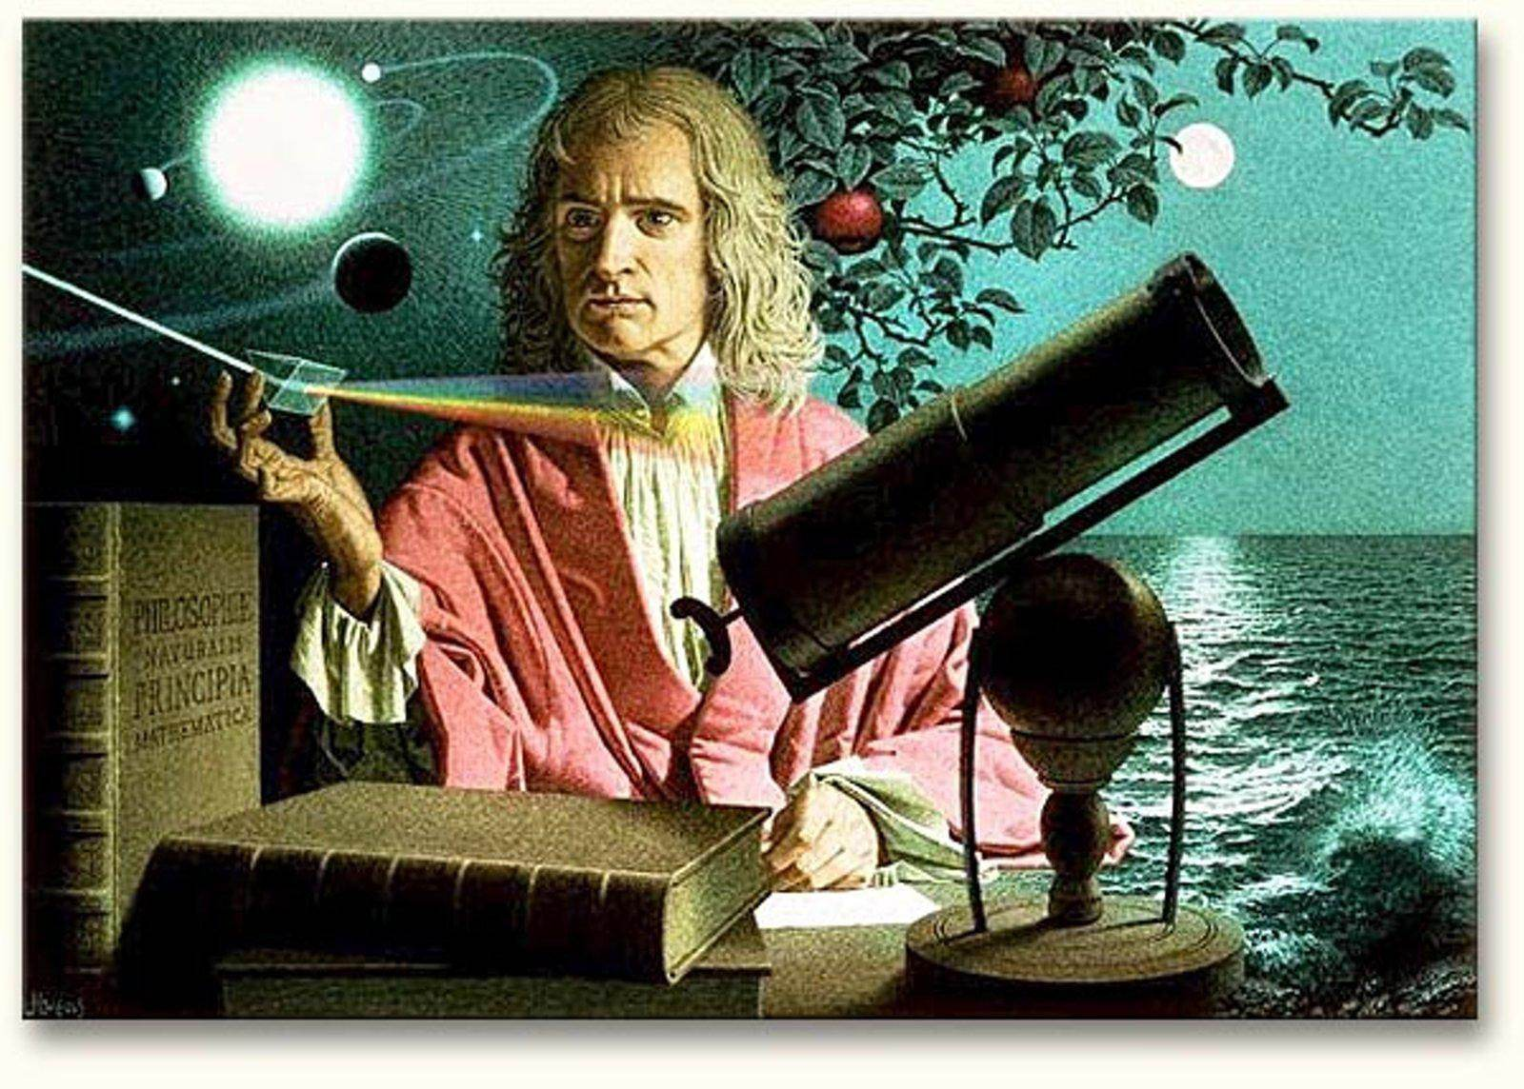
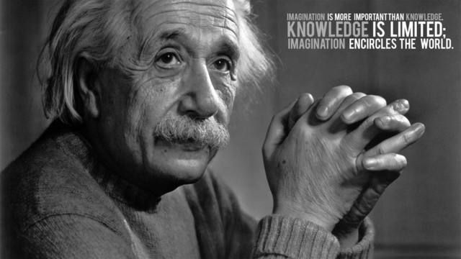
When you think of science, what will you think of?
Some great scientists

Slide 4
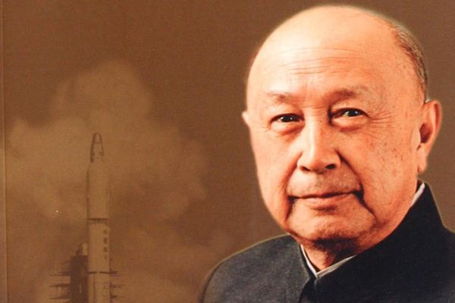
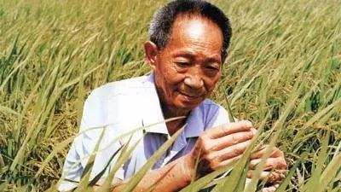
Great scientists who have made great contributions to our country.
Qian Xuesen
Yuan Longping

Slide 5
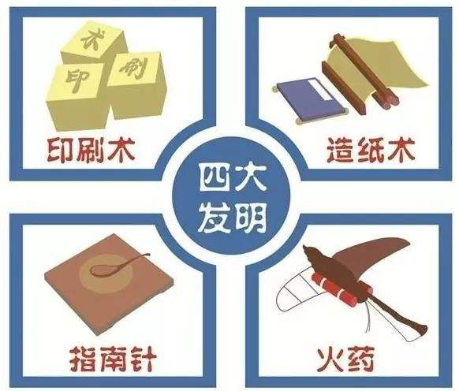
Some great scientific discoveries or inventions.
The Four Great Inventions in ancient China
Gunpowder, Printing Technique, Papermaking, Compass

Slide 6
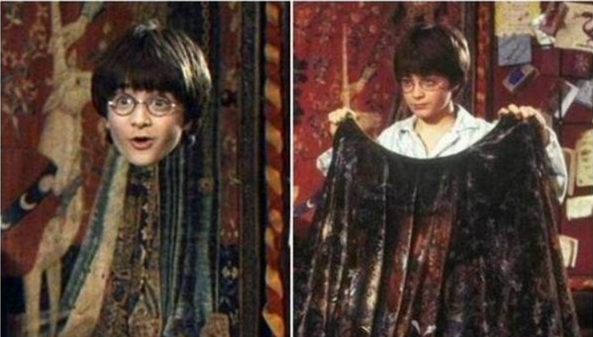
Harry threw the cloak around his shoulders… Harry looked down at his feet, but they were gone.
invisibility cloak

Slide 7
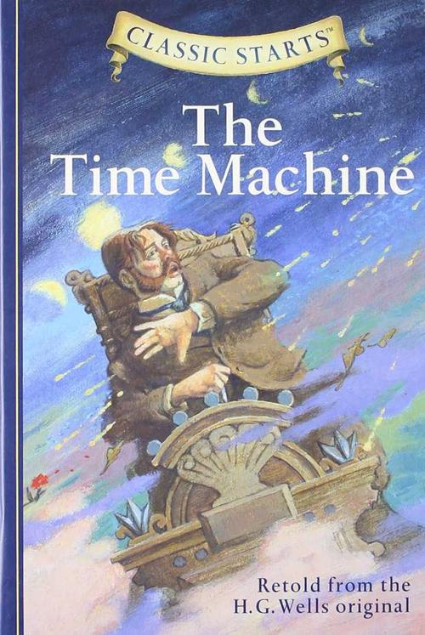
Presently I am going to press the lever（杠杆; 操作杆）, and off the machine will go. It will vanish, pass into future time, and disappear.
The Time Machine

Slide 8
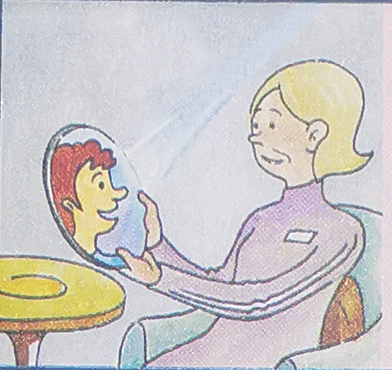
A faint blue light shot across it, darkening to purple, and presently she could see the image of her son, who lived on the other side of the earth, and he could see her.
The Machine Stops

Slide 9
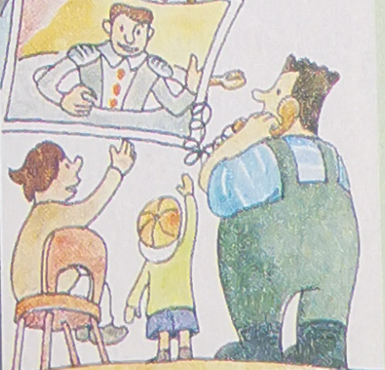
Instead of being printed, the Earth Chronicle [ˈkrɒnɪkl]编年史 is every morning spoken to subscribers, who, in interesting conversations with reporters, statesmen, and scientists, learn the news of the day.
In the Year 2889

Slide 10
Activity 1: Look at the pictures and read about the inventions from famous novels and choose those that have become a reality.
The third and fourth inventions have become a reality. People nowadays can have video chats with each other via mobile phones and computers connected to the Internet. And many newspapers have offered their readers free digital editions. Furthermore, live chat rooms make it possible for people to communicate with reporters, statesmen and scientists.

Slide 11
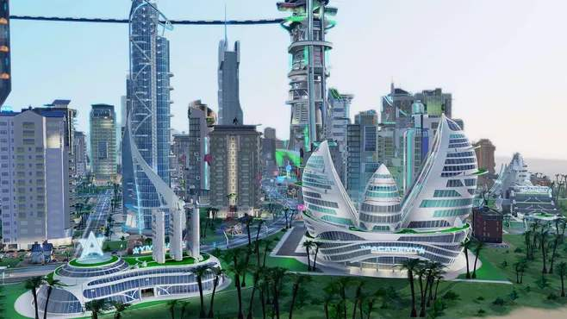
Activity 2: Watch the video and answer the questions
1. Which of the inventions in the video interests you most? Why? (open)
2. Which of the inventions in the video do you think will become a reality? (open)
3. Of all the inventions in the world, which do you think is the most useful? why? (open)
4. Do you have any ideas about future inventions? (open)

Slide 12
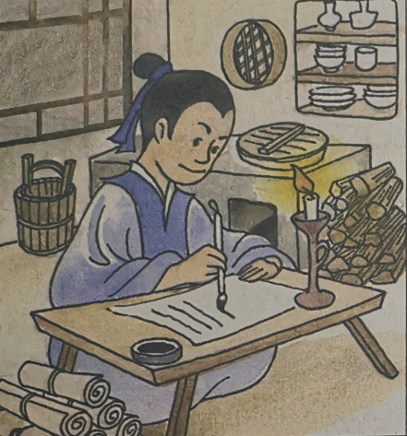
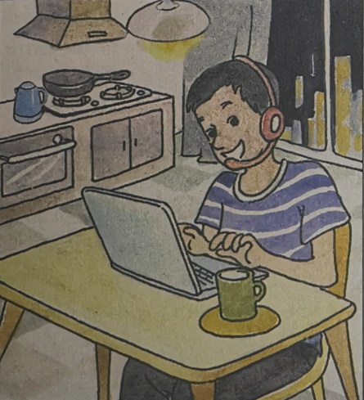
Step 2: Understanding Ideas
Task 1: Before reading
Activity 1: Look at the pictures and talk about how the way we live has changed over time. Discuss the reasons behind these changes.

Slide 13
In ancient time
What is he doing?
What is he using to write?
What is he using to make his room bright?
What is he using to get water?
What is he using to cook his meals?

Slide 14
In modern time
What is he doing?
What is he using to write?
What is he using to make his room bright?
What is he using to get water?
What is he using to cook his meals?

Slide 15
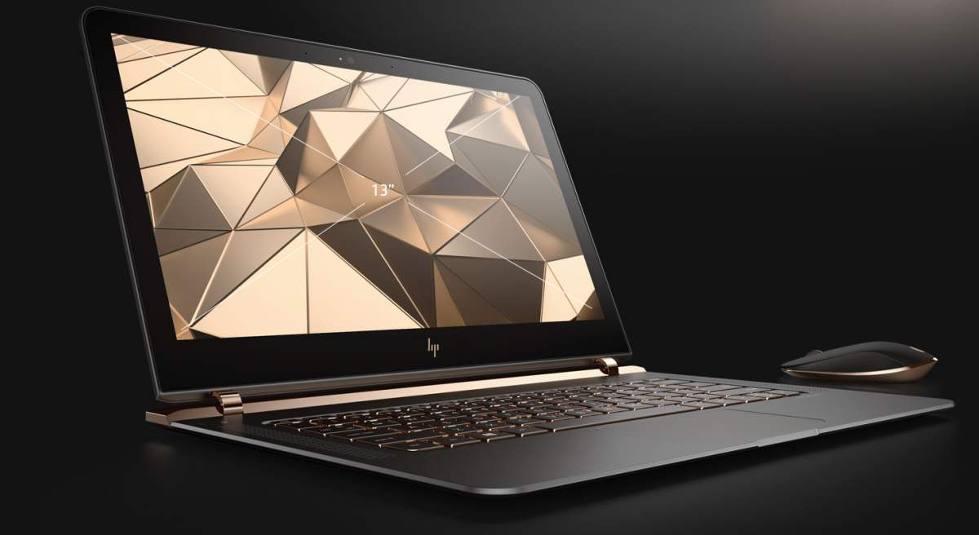
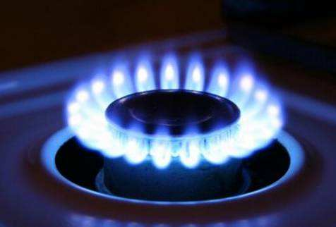
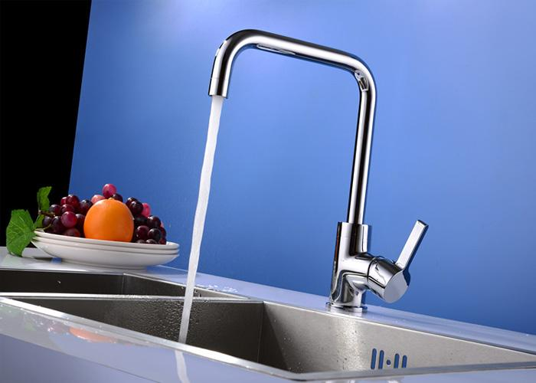
The reasons behind these changes are some inventions that make our lives convenient.

Slide 16
Task 2: Between reading
Activity 2: Read the interview and find out what inventions are mentioned.

Slide 17
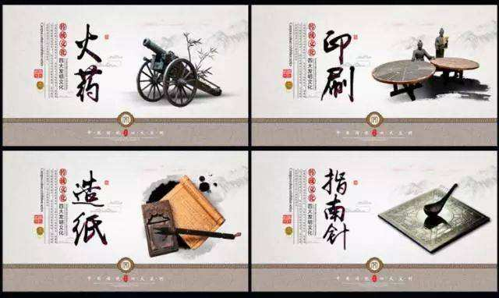
The Four Great Inventions in ancient China
gunpowder, papermaking, printing and the
compass

Slide 18
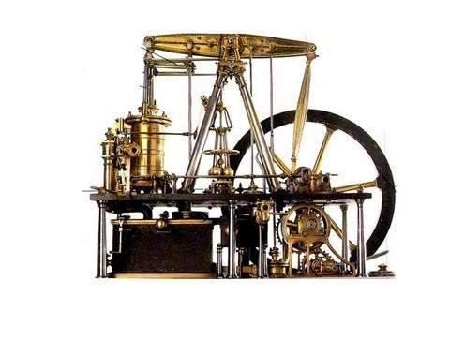
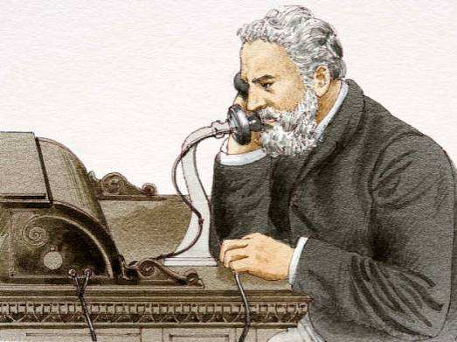
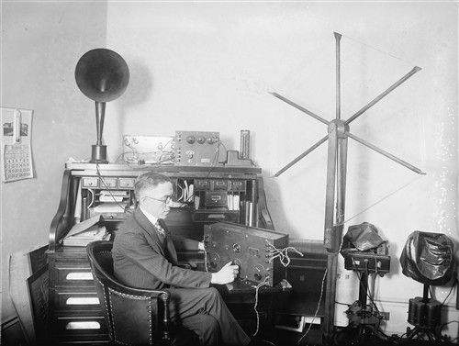
Some western inventions:
steam engine
telephone
radio

Slide 19
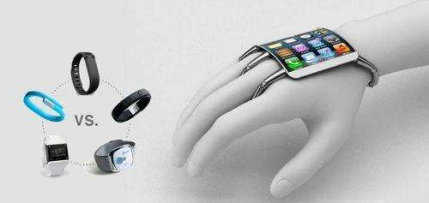
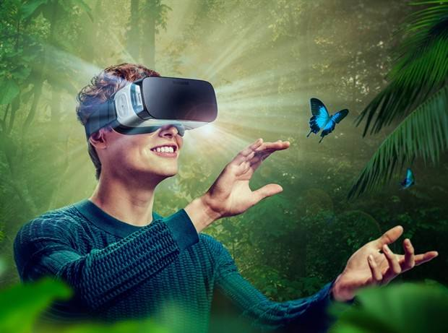
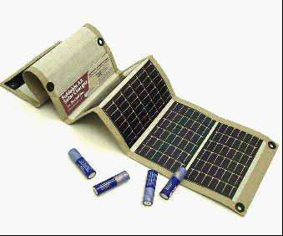
Some new inventions
tech-based:
wearable tech
VR (virtual reality)
flexible battery

Slide 20
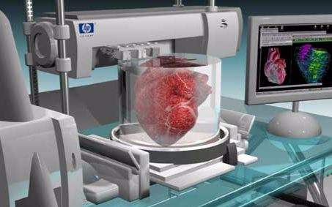
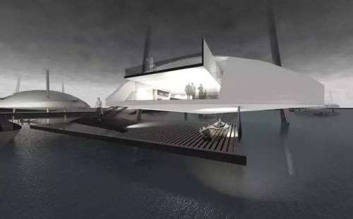
Some new inventions in medicine and environmental science:
intelligent walking house
3D-printing organs

Slide 21
Activity 3: Choose the sentences that describe Dr Fairhurst’s opinions.
1. Inventions in Ancient China were better than those in the West.
2. A lot of today’s great inventions are tech-based.
3. Today, most inventions prefer working by themselves.
4. The desire to solve problems inspires invention.
5. A time machine will definitely be invented in the future.

Slide 22
the four great inventions/ gunpowder, papermaking, printing and the compass
the steam engine,
the telephone, and the radio
the flexible battery
hearts and bone parts
a problem that needs a solution
an intelligent walking house
an incredible desire to think and create
solar technology

Slide 23
Task 3: Beyond reading Think and Share
1. If you were the interviewer, what other questions would you ask Dr Richard Fairhurst?
2. In your opinion, what else inspires people to invent things?

