Slide 1
Disaster and hope

Slide 3
Watch & Share
1. Where is the city? What happened there?
2. How did people there react to the disaster?
What was the result?

Slide 5
Watch & Share
1. Where is the city? What happened there?
2. How did people there react to the disaster?
What was the result?
The city was in Italy. It was close to a volcano and in the year 79 AD, the volcano erupted, and the city was destroyed.
People there were frightened by the sudden disaster. They took what whey could as they tried to get away from the city.
Many people were trapped by the buildings that were falling down, and killed by the powerful flow of gas, ash and rock.

Slide 6
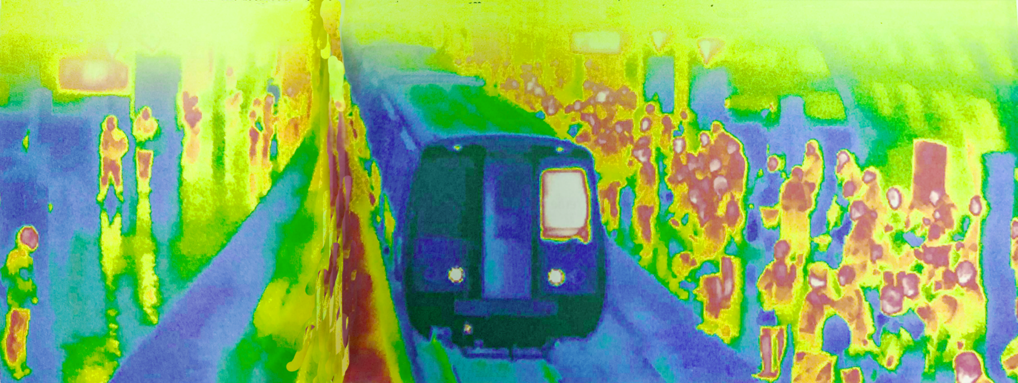
Step 2 Before reading
Activity: Look at the picture and predict what the passage is about.
The passage is about the author's feelings and concerns on the London Tube on an unusually hot day

Slide 7
Step 3 While reading
Activity 1: Choose the author’s purpose in writing the passage.
1 To explain why summers in London are getting hotter and hotter.
2 To complain about the London Tube.
3 To warn people about the danger of London being flooded.
4 To express his worries about the dangers of extreme weather conditions.

Slide 8
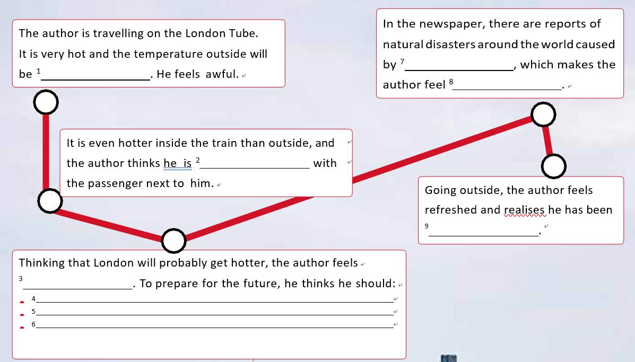
Activity 2: Complete the flow chart.
climate change
30 plus degrees
nervous
melting and becoming one
worrying too much
a bit scared
put his flat on the market and buy a boat
speak with his manager about moving to the top floor
learn to swim

Slide 9
Step 4: Think & Share
Do you share the author’s concerns aobut extreme weather conditions? Why?
2. Do you think climate change will affect your life in the future? How would you adapt?

Slide 10
Step 5 Fill in the blank. (课文语法填空)
Today, the temperature in London 1. (expect) to reach 30 plus degrees! However, it is nothing 2._________ (compare) to the train. The temperature inside the train can reach 35 degrees. Each summer in London seems 3. ______ (hot) than the last. I suddenly feel a bit 4. _____ (scare). Maybe it's time for me to plan for the future. I probably should sell my flat and buy a boat so that I can still go to work when there is a flood in London, 5. ___I should join a beginner's swimming class 6.____________ (immediate) to learn to swim.
Looking 7.________the newspaper inside the train, I'm shocked by photos showing the damage 8.________ (cause) by many natural disasters like hurricanes, landslides and forest fires, 9._________occur due to climate change. When I am concerned about these, there comes the 10._______________(announce), telling me it's my destination. With a fresh wind on my face outside, I think maybe I have been worrying too much.
is expected
compared
hotter
scared
or
immediately
through
caused
which
announcement

