Slide 1
Period 4 Using Language
点击此处可添加副标题

Slide 2
Step 1: 透析单元语法
省略(Ellipsis): 英语中有时为了避免重复，使语言简练紧凑，在不影响句子结构和意义的前提下，往往省去一个或多个句子成分或词语，这种语法现象称为省略。
Eg: 1）It’s typical that my journey is on one of the oldest lines,
as well as one of the deepest (lines).
2）My office is only on the third floor of the building, so (it is)
quite low.

Slide 3
一、简单句中的省略
在简单句中，可省略主语、谓语或谓语的一部分、宾语等，有时甚至同时省略若干成分。如：
1）(You) Hand me the book over there.
2）(Is) Anybody against the suggestion?
3）—What do you think made David so happy?
—Passing his driving test (made him happy).

Slide 4
二、并列句中的省略
在并列句中，如果后面的分句与前面的分句中有相同的成分，常被省略，以避免重复。如：
1）I arrived here today, and (I) must stay here one or two weeks.
（省略主语）
2）I asked John to go, but she (asked John) to stay.
（省略谓语和宾语）

Slide 5
3）Knowing is one thing, and believing (is) another thing.
（省略系动词）
4）In my class, boys like sports while girls do not (like sports).
（省略谓语和宾语）
5）My father looked angry, and I certainly was (angry).
(省略表语)

Slide 6
三、复合句中的省略
1、定语从句中的省略
在限制性定语从句中，可省略在从句中作宾语的关系代词that, which, whom, who；但如果关系代词作介词的宾语,且介词置于关系代词之前时，则不可省略关系代词。如：
1）That is the film (which / that) we watched last week.
2）Tom isn’t a man (whom / that / who) you can believe in.
3）The athlete to whom you talked is a famous runner.

Slide 7
注意：当先行词为the way时,从句用that或in which引导, that或in which也常被省略。如：
We admired him for the way (in which / that) he faces his difficulties.
2、状语从句中的省略
在状语从句中，如从句的主语与主句的主语一致并且从句中谓语中又包含系动词be时，可以省略从句中的主语和be。另外，若状语从句为it/there+be结构时，也可省略it/there+be。如：

Slide 8
1）While (I was) in Hangzhou, I paid a visit to the West Lake.
2）The computer is of no use unless (it is) repaired.
3）Although (he is) still young, he knows a lot.
4）Hand in the work tomorrow if (it is) possible.

Slide 9
3、宾语从句中的省略
在宾语从句中，连词that一般可以省略；但介词+形式宾语it+宾语从句中的that不可省。宾语从句中包含that引导的两个或两个以上的并列宾语从句时，通常只有第一个that可以省略。如：
1）I don’t believe (that) Mike has joined the army.
2）You may depend on it that I shall always help you.
3）Lisa told me (that) she was ill and that she couldn’t go to school the next day.

Slide 10
注意：有时可用so或not代替上文的内容。如：
1）Work hard. If not (If you don’t work hard), you
will fail in the exam.
2）—Do you think Mr. Green will give us help?
—I hope so. (I hope he will give us help.)

Slide 11
【拓展】动词不定式中为了避免重复，常省去前面出现的相同部分，而只保留不定式符号to；如果在省略的不定式结构中含有系动词be或助动词have/ have been时，这些词要保留。如：
1）I asked my friend to have a drink, but he didn’t want to
(have a drink).
2）—Are you a teacher now?
—No, but I used to be (a teacher).

Slide 12
Activity 2 on Page 65
Technology isn’t the only way to forecast the weather. Nature has its ways (____________________), too. Unusual animal behavior, for example, can indicate whether it’s cold, wet weather that’s on the way or a hot, dry period (______________). If fish are jumping higher than usual or frogs are croaking more loudly (_________), it may rain. And next time you look up at the sky, don’t just look for rain clouds, but also (______) for birds. If they are flying low, grab your umbrella. It is also said that mice and snakes head for safer ground several days before an earthquake, while dogs avoiding the beach may be a sign that a tsunami is approaching.
to forecast the weather
of weather
than usual
look

Slide 13
Of course, although these things may suggest something bad is going to happen, they won’t tell us when (__________)and where (____________). So, for accurate and reliable predictions, it’s best to check an official, scientific report.
to happen
to happen

Slide 14
Activity 3 on Page 65
The 8.1-magnitude earthquake that hit Nepal on 25 April 2015, was one of the worst earthquakes in history. On hearing the news, China was quick to start organising emergency aid.
International rescue teams soon began to arrive in the country. Amongst all the international heavy rescue teams, the China International Search and Rescue Team (CISAP) was the first international heavy rescue team to arrive. Consisting of 62 people, it not only included rescuers and medical staff, but also included earthquake experts. By early May, emergency Aid worth 9.7 million US dollars had been donated by China, with a further round
of emergency aid to follow.

Slide 15
Exercise 2: 单句语法填空
1）Although (order) to stop, the driver kept on driving as fast as he could.
2）He succeeded in solving all the problems as (expect).
3）The purpose of new technologies is to make life easier, not ____________ (make) it more difficult.
4）He had a wonderful childhood when (travel) with his mother to all corners of the world.
5）When (offer) an important role in a new movie, Andy got a chance to become famous.
6）Though (tire), they went on working in order to finish the task on time.
7）Some diseases are not all dangerous if (treat) in time.
8）What I want to do is (have) a good rest.
ordered
expected
to make
travel(l)ing
offered
tired
treated
have

Slide 16
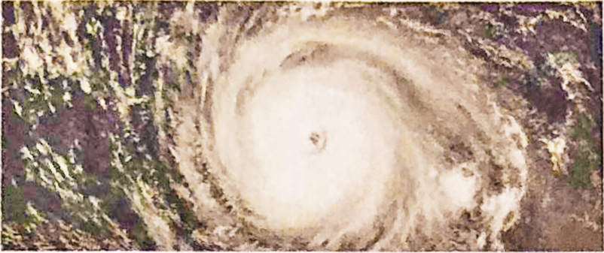
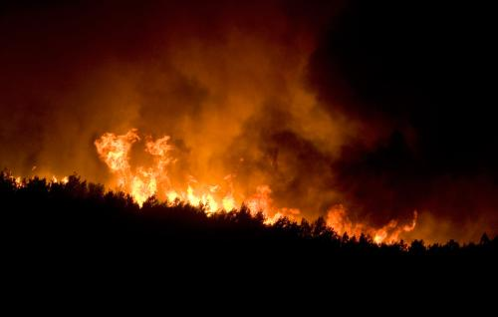
Types of natural disasters
Activity 5: Complete the reports with the words in Activity 4.
In 1881, an __________ struck the small Vietnamese city of Haiphong, bringing terrible strong winds. When it hit the coast, huge tidal waves caused sever flood, costing the lives of up to 300,000 citizens.
typhoon
In August 1949, the Landes region of South-west France faced a major ________ that lasted almost a week. Some 500 km of forested land was burnt and 82 people killed. Even today, it is considered one of Europe’s most deadly forest fires.
wildfire

Slide 17
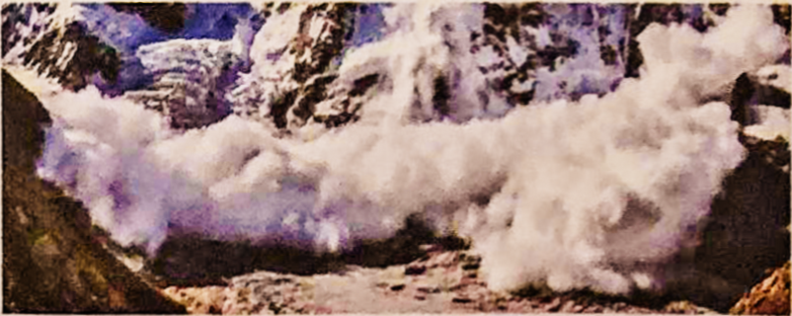
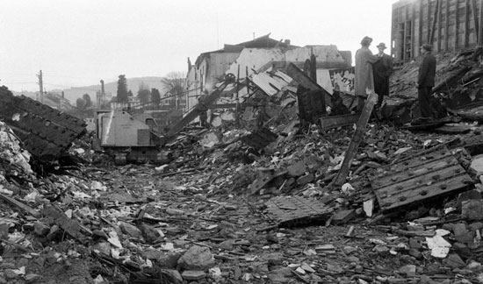
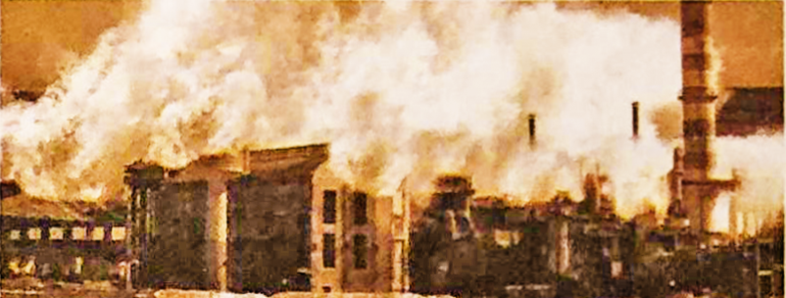
The winter of 1950 to 1951 came to be known as the Winter of Terror when over 600 __________________ struck towns and villages in the mountains of the Swiss-Austrian Alps. Caused by exceptionally heavy snowfall within a short period of time, they destroyed buildings and forests, and claimed over 256 lives.
avalanche /ˈævəlɑːnʃ/
earthquake
In 1960, Chile suffered the strongest ____________ to be recorded in the 20th century. The shock is generally agreed to have had a magnitude of 9.5. It caused a(n) _______ with waves of up to 25 metres affecting places as far away as Hawaii and Japan.
tsunami

Slide 18
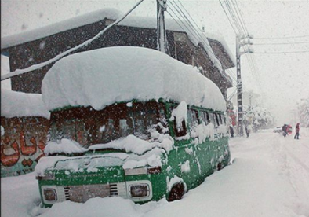
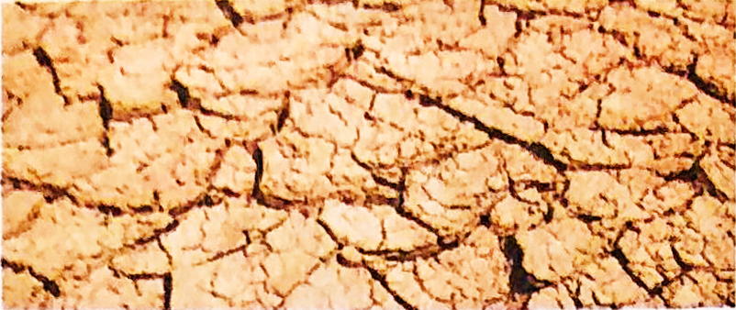
A(n) ________________ hit Iran in February 1972, causing a week of extremely low temperatures. Winter storms brought as much as 7.9 metres of snow in the south of the country, resulting in the deaths of about 4,000 people.
blizzard /ˈblɪzəd/
In July 2011, a(n) __________ struck East Africa. It was said to be the worst in 60 years, and not a single drop of rain fell for almost a whole year. It led to a sever food crisis and threatened the livelihoods of more than 9.5 million people.
drought

Slide 19
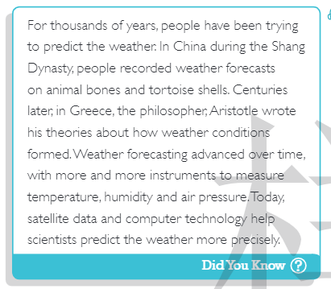

Slide 20
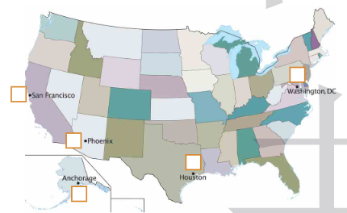
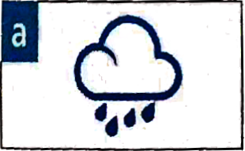
Listen to the weather forecast and match the weather symbols to the locations on the map.

Slide 21
Listen again and complete the form.
Anchorage
You will need _________________.
Temperatures will stay around ______℃.
warm clothes
-15
Phoenix
Temperatures are really high and it’s probably hot enough to __________________________.
Be sure to __________________ if you or others have symptoms of heatstroke.
fry meat on the road
get medical attention

Slide 22
Houston
It’s ___________ season and there will be a big one across the Atlantic.
Stay ___________ and listen out for the latest forecasts.
hurricane
safe indoors
Washington, DC
Temperatures are going to stay around _______℃.
Don’t drive ______________________!
13
through floodwaters

Slide 23
San Francisco
Temperatures are going to be around ______℃.
People are suffering from __________ which are causing damage and loss.
25
wildfires

Slide 24
听力文本：
Good morning USA, and welcome to today's weather report for Monday April 3. As we all know, this year, 2080 has so far had a lot of extreme weather. Get ready for a lot more! First let's look at Anchorage, where there is some unusually cold weather for this time of year. Be sure to wear warm clothes- you're going to need them if you do have to go outside! We’re going to see some heavy snow over the next week, with temperature staying around- 15 degrees.
In contrast to Anchorage, residents of Phoenix are going to experience another kind of extreme weather. They are about to be hit by temperature of up to ... wow, 52 degrees! That's probably not enough to fry meat on the road! Seriously, though, drink lots of water and try to stay cool. Be sure to get medical attention if you or others have symptoms of heat stroke.

Slide 25
In Houston, temperatures will stay around 30 degrees. We all know that this
time of year is hurricane season near the Gulf of Mexico, and there is a big
one coming our way across the Atlantic. Be sure to stay safe indoors and
listen out for the latest forecasts.Temperatures are going to stay around 13
degrees in Washington, DC. But there is yet more rain expected. That's 14
days of rain in a row for the city. Some advice for everyone there - do not try to drive through floodwaters! And if you must drive in the rain,
drive slowly and steadily.

Slide 26
In San Francisco, temperatures will be moderate around 25 degrees.
However, this is combined with the dry California climate and a strong
wind force of 8. This is not good news at all for the firefighters trying to
control the wildfires outside the city. We are all thinking about people
there who have lost their homes and belongings. If you want to help, please listen for details about how to make a donation after this report.

Slide 27
Step 4: Important phrases in using language 1. 夺取256人多的生命 (P66)
2. 导致大约4000人的死亡 (P66)
3. 留心听最新的预报 (P67)
claim over 256 lives
result in the death of about 4,000 people
4.导致严重的食物危机（P66）
5.威胁......的生活 （66）
listen out for the latest forecasts
lead to a severe food crisis
threaten the livelihood of

