Slide 1

Developing Ideas
& Presenting Ideas

Slide 2
Step 1 Before reading
Activity: Look at the map and answer the questions on P68.
Where did Hurricane Katrina form?
2. Where did it hit?
3. How long did it last?
4. How many people lost their lives in the hurricane?
5. What was the cost of the damage Hurricane Katrina caused?
Katrina formed on the Atlantic Ocean, where there was a tropical depression.
It hit mainly the Southern states, including the south of Florida, Louisiana, Mississippi, and Alabama.
It lasted more than one week.
Over 1800 people lost their lives in the hurricane.
It caused USD 108 billion in damage.

Slide 3
Step 2 While reading
Activity 1: Read the passage and answer the questions.
1. What’s the type of the passage?
2. What is your understanding of the title?
Narrative.

Slide 4
Activity 2: Divide the passage into 4 parts.
1 – 2
Para _______ During the hurricane
Para _______ Right after the hurricane
Para _______ A few days later
Para _______ One year later
3 – 4
5
6

Slide 5
Activity 3: Complete the diagram with words and expressions from the passage on P70.

Slide 6
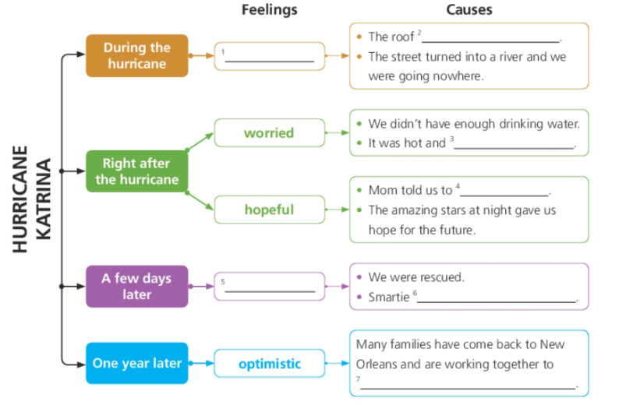
flew off/was blown away
frightened
smelt so bad everywhere
always try to see the
good side of things
happy
came home just in time
rebuild our homes and our lives

Slide 7
Step 3 Post reading
Activity: Discuss and answer the following quesitons.
1. Why does the author say “Although it was only a few days before we were rescued, it felt like months”?
2. What sort of attitude to life is reflected in the author’s experience of looking at the night sky?
Because they lost their home and suffered a lot from the hurricane. It was so hard to spend those miserable days that seemed endless.
It reflects a positive attitude to the hardships in life. Stars in the night sky stand for the hope that gives them the confidence to move on and rebuild their homes and lives.

Slide 8
Step 4 Important Phrases and Sentences
1)飞走
2)突然
3)下落，下降
4)来来回回
5)寻找
6)在户外，露天
7)继续做某事
8)尽管，即使
9)及时
10)还没有做某事
11)被...包围
12)前进
fly off
all of a sudden
come down
up and down
look out for
in the open air
keep on doing sth.
even though
in time
have yet to do sth.
be surrounded by
move on

Slide 9
13) I was sitting in my room with my cat, Smartie, on my lap, the roof just (fly) off.
14) All of a sudden, there was sky the roof had been.
15) There was water everywhere, but we couldn’t drink any of it_________we’d get really sick.
16) I was so frightened that I just (freeze).
17) I just spent the days watching the boats (go) up and down and looking out for Smartie.
18) (thank), Smartie came home just ____ time.
19)Now we have another chance (look) up at the stars of New Orleans, their beauty (inspire) us and giving us __________ (confident) to move on.
_______________(prepare) is the best way to increase your chances of _________(survive).
Some families have yet ____(return), but many others have come back.
when
flew
where
otherwise
froze
going
Thankfully
in
to look
inspiring
confidence
Being prepared
survival
to return

Slide 10
21) He had disappeared the moment the storm hit.
the moment/minute/second (that)…意为“一…就…”，相当于as soon as或immediately，前面可以加very等形容词来修饰，that经常可以省略。
① 他一到家就给我打了电话。
② 我太累了以至于一闭上眼就睡着了。
The moment/minute/second he arrived at his home he called me.
He called me the moment/minute/second he arrived at his home.
He called me immediately he arrived at his home.
I was so tired that________________________________________
_______________________________________________________
the moment/minute/second I closed my eyes I
fell asleep.

Slide 11
Step 5 Writing
Activity: Read the hurricane safety guidelines on P71 and think about what type of language is used in safety guidelines.
Concise and simple language is used, with many imperative sentences as tips.

Slide 12
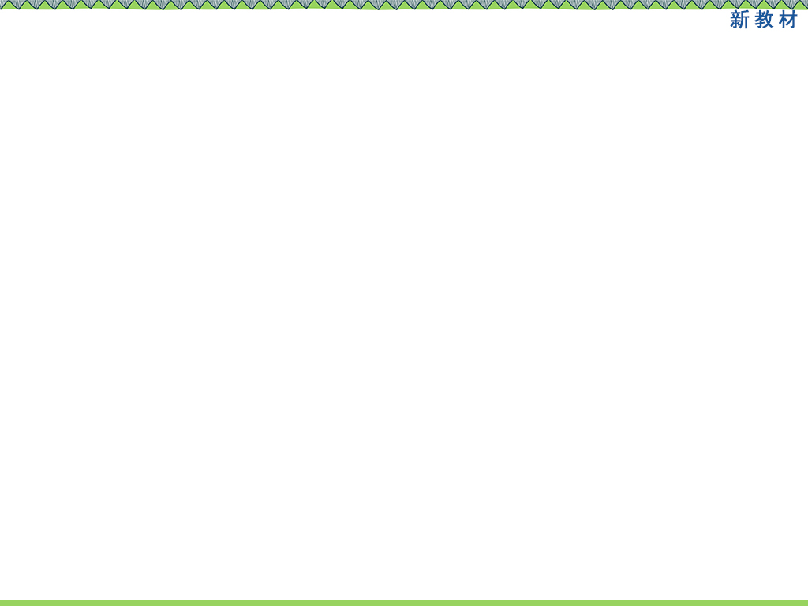
写作指导
【如何写安全准则】
安全准则是上级对下级、组织对成员、政府对民众等布置安全工作、传达安全建议等使用的一种应用文体，在日常生活和工作中为人们广泛使用。安全准则由两部分组成，即开头语和正文。行文中要注意其语言特点和叙述特点。

Slide 13
1.语言特点：多用一般现在时。安全准则主要表达日常工作、学习和生活中的注意事项，因此文中时态以一般现在时态为主；
多用祈使句。安全准则主要用于对活动参加者提出的要求或注意事项。
多用简单句。写安全准则的目的是把将要进行的活动及有关事项交代清楚，所以采用的句子必须简洁明了，以短句、单句为主，能使读者一目了然。

Slide 14
2.叙述特点
按类别分层展开叙述注意事项。每个事项用一个或多个句子表达，这样能使层次清晰，切忌用一个句子表达几个事项。罗列信息点时，按主次、详略、类别、时间等顺序排列，以确定先写什么后写什么。用文字表示时，必须做到明确清楚，不能含糊其辞。

Slide 15
【增分表达】
1.高级词汇
(1) pay attention to safety
(2) result in a great loss
(3) in case of fire
(4) turn off the power supply
(5) obey traffic rules
(6) join in basic medical training
(7) escape from an accident
(8) give sb. detailed instructions on how to escape
(9) be trapped/buried under the ruins

Slide 16
2.高级句式
(1) People living in the low-lying (低洼的) areas should leave there to protect themselves from the flood.
(2) Bend down to escape from the fire as soon as a fire breaks out.
(3) Provide regular first aid training for the public so as to improve their knowledge of first aid.
(4) It takes us only 2 minutes and 45 seconds to gather at the playground.
(5) The earthquake drill (演练) is important for us students, from which we have learned how to escape and protect ourselves when an earthquake happens.
(6) After the earthquake, we should leave the dangerous area immediately in case of strong aftershocks.
(7) The first thing to do is ...
(8) It’s important (not) to ...

Slide 17
3. 过渡词
to begin with, secondly, in addition, at first, then, later on, soon, afterwards, finally, at last, soon after that, in particular

Slide 18
【参考范文】
Flood Safety Guidelines
Flood is one of the most dangerous natural disasters. It may come suddenly and sweep away everything. It is important to learn some safety guidelines and get prepared for a flood, especially for those living near a river. Here are some tips on flood safety.
The first thing to do is listen to the weather warnings. Move to a safe place immediately if there is an order. In addition, make sure you have sufficient food and drinking water. Preparing a safeguard and a first aid kit is also useful. When the flood comes, try to move to a place high enough to keep clear of floodwater. If you are in water, hold to a tree or a wood block. Do remember to keep away from electricity. Don’t stay in the water just for your property. Never lose your life. Remember that life is the treasure. Try to get help and try to help others. It’s important to rebuild your hometown soon after the flood is gone.

Slide 19

【相关主题例文赏析】
假定你是学生会主席，当前新型冠状病毒肆虐，请你围绕“从小事做起共战疫情”这一主题，给全校学生写一封英文倡议书。
要点如下：
1. 倡议的原因和目的；
2. 倡议的具体内容；
3. 发出倡议。
注意：
1. 词数80左右；
2. 可以适当增加细节，以使行文连贯。

Slide 20
Dear schoolmates,
Recently, the novel coronavirus has made its way around China. It has a strong impact on our life and study(对我们的生活和学习有很大的影响). Faced with the crisis(面对这场危机), we students should respond actively to the appeal (积极响应号召)from authority and experts. In order to ease the serious condition, all of the students had better do as follows.
First of all, stay at home and don’t go out if not necessary(不必要不外出). Be responsible for yourself and others. In addition, do wear masks (务必佩戴口罩)while you are in the open air. As we all know, it can reduce the risk of contracting the virus. Washing hands as often as possible is needed, too. Most importantly(最重要的是), everyone ought to have a positive attitude to (对......持积极态度)the campaign with the disease. Attitude is everything.
My dear friends, there may be a long way to go for us. Let’s work hand in hand to overcome anxiety(克服焦虑) and do some bits. We have faith in the fact that (我们相信) tomorrow is another day.
The Students’ Union
Feb. 14th, 2020

